Slide 1
Disynaptic Inhibition Effect of Hilar Mossy Cells on Pattern Separation in Hippocampal Dentate Gyrus
S.-Y. Kim and W. Lim
Institute for Computational Neuroscience
Daegu National University of Education
• Hippocampus
- Consisting of the dentate gyrus (DG) and the areas CA3 and CA1
- Play a key role in memory formation, storage, and retrieval
• Pattern Separation
- Pattern Separation: Transforming input patterns into sparser and orthogonalized patterns
- DG: Pre-processor for the CA3: Granule cells (GCs) in the DG performs pattern separation,
facilitating pattern storage and retrieval in the CA3
- Sparsity → Enhancing the pattern separation
• Purpose of Our Study
Investigation of Disynaptic Inhibition Effect of Mossy Cells (MCs) Mediated by
Basket Cells (BCs) on The Pattern Separation in The Hippocampal Dentate Gyrus
1

Slide 2
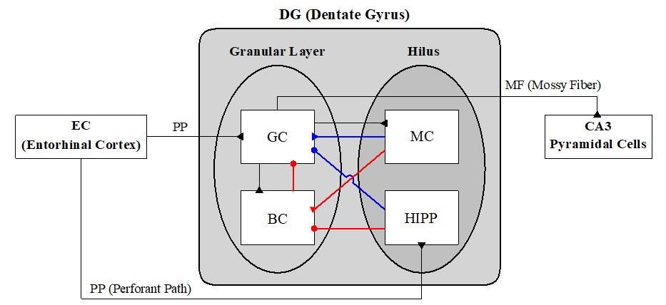

Hippocampal DG Network
• Cells in DG Network
- DG receives inputs from
the entorhinal cortex
(EC) via the perforant
paths (PPs)
- Granular Layer:
Excitatory granule cells
(GCs): providing the
output to the CA3 via
the mossy fibers (MFs)
Inhibitory basket cells
(BCs)
- Hilus: Excitatory mossy cells (MCs) & Inhibitory hilar perforant path-associated (HIPP) cells
- Disynaptic connections on GCs (Red lines) mediated by BCs:
MC → BC → GC & HIPP → BC → GC
- Monosynaptic connections on GCs (Blue lines):
MC → GC & HIPP → GC
• Architecture of The DG Network
- EC Ring Network: $N_{EC}(=400)$ EC cells
- Granular-layer Ring Network: $N_{C}(=20)$ GC clusters, $N_{GC}(=100)$ GCs & one BC
in each GC cluster → Total No. of GCs = 2000 & No. of BCs $N_{BC}$ = 20
- Hilus Ring Network: $N_{MC}(=80)$ MCs & $N_{HIPP}(=40)$ HIPP cells
2

Slide 3
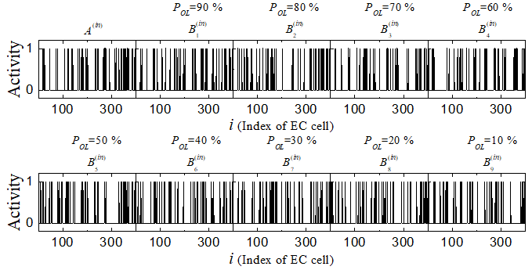
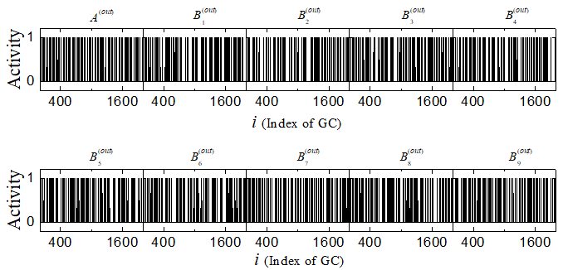

Binary Representation of Spiking Activity
• Binary Representation of
Spiking Activity of EC Cells
- Direct Excitatory EC Inputs via PP
Input density = 10 %
40 active EC cells
& Remaining ones: silent
Active EC cells: at least one spike
during the stimulus stage (1)
otherwise, silent EC cells (0)
- $A^{(in)}$ : Randomly-chosen input
pattern
Construct another input patterns $B_{i}^{(in)}$ with the overlap percentage $P_{OL}$
• Binary Representation of
Spiking Activity of GCs
Active GCs: at least one spike
during the stimulus stage (1)
otherwise, silent GCs (0)
3

Slide 4
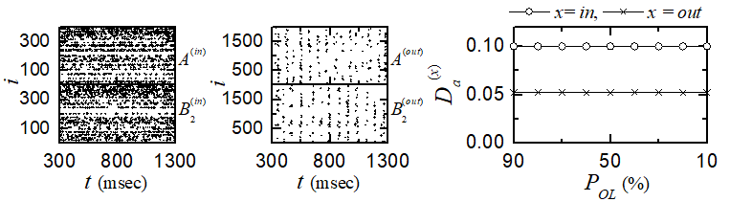
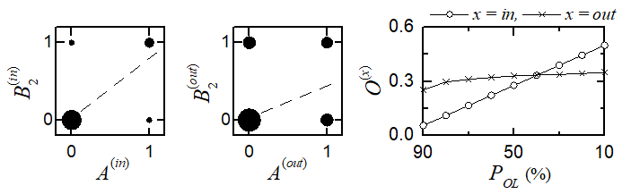
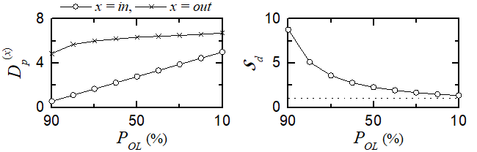

Characterization of Pattern Separation
• Activation Degrees
- GCs: More sparse firings than
EC cells
- Average activation degree:
$D_{a}^{\left(in\right)}$(=0.1) > $D_{a}^{\left(out\right)}$(=0.052)
• Orthogonalization Degrees
- Pearson’s correlation coefficient $ρ^{\left(x\right)}$:
denoting similarity degree
between two patterns
- Orthogonalization degree:
$O^{(x)}=(1−ρ^{\left(x\right)})/2; x =in, out$
representing dissimilarity degree between two patterns
$P_{OL}≥40\%$ → $O^{\left(out\right)}>O^{\left(in\right)}$, $P_{OL}<40\%$ → $O^{\left(in\right)}>O^{\left(out\right)}$
• Pattern Distance and Pattern Separation Degree
- Pattern distance: $𝒟_{p}^{(x)}=O^{(x)}/D_{a}^{(x)}$
- Pattern separation degree:
$𝒮_{d}=𝒟_{p}^{\left(out\right)}/𝒟_{p}^{\left(in\right)}$
$𝒮_{d}>1$ for all values of $P_{OL}$
→ Pattern separation occurs
4

Slide 5
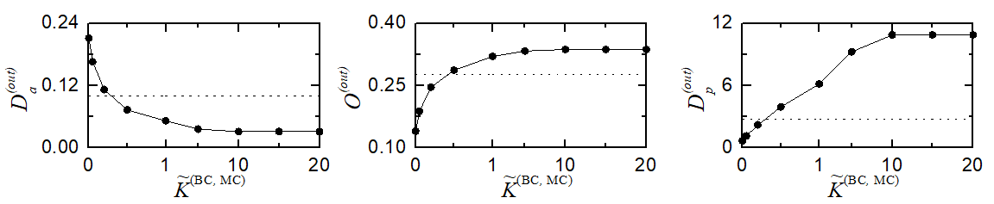
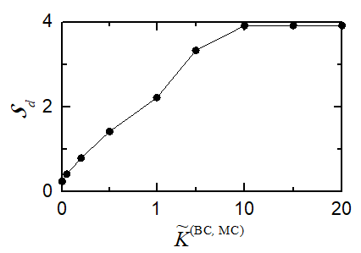

Disynaptic Effect of Hilar Mossy Cells on Pattern Separation
• Disynaptic Effect on Pattern Distance
- Normalized synaptic strength:
${\tilde{K}}_{R}^{\left(BC,MC\right)}(=K_{R}^{\left(BC,MC\right)}/{K_{R}^{\left(BC,MC\right)}}^{∗})$; R = AMPA or NMDA, ${K_{R}^{\left(BC,MC\right)}}^{∗}:$Original default value
- Disynaptic effect of MCs
With increasing ${\tilde{K}}^{(BC,MC)}$, $D_{a}^{(out)}$ decreases from 0.221 and becomes saturate to 0.031
$O^{(out)}$ increases from 0.140 and gets saturated to 0.337
$D_{p}^{(out)}$ increases from 0.664 and becomes saturated to 10.871
• Disynaptic Effect on Pattern Separation Degree
- Disynaptic effect of MCs:
With increasing ${\tilde{K}}^{(BC,MC)}$, $𝒮_{d}$ increases and becomes saturated
to 3.913.
${\tilde{K}}^{(BC,MC)}$>0.29, $𝒮_{d}$>1 → Pattern separation occurs.
5

Slide 6
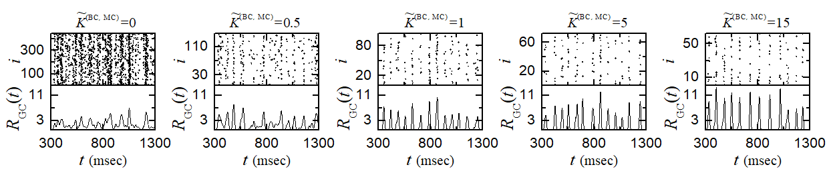
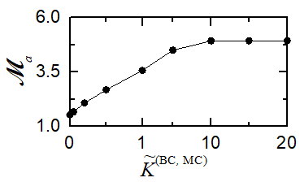
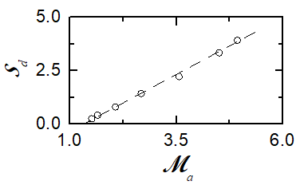

Sparsely Synchronized Rhythms of the Active GCs
• Synchronous Oscillations of Active GCs
- As ${\tilde{K}}^{(BC,MC)}$ increases, the synchronization degree of the sparsely synchronized rhythm is
increased.
• Population Behavior of GCs
- Synchronization degree $ℳ_{a}$:
With increasing ${\tilde{K}}^{(BC,MC)}$, $ℳ_{a}$ increases from 1.519 and
becomes saturated to 4.931
• Relation between Sparsely Synchronized Rhythm
and Pattern Separation
- Positive correlation between $𝒮_{d}$and $ℳ_{a}$
$r=0.9987$
6

Slide 7
Summary
• Pattern Separation
- Granule cells (GCs) in the hippocampal DG performs pattern separation
on the inputs from the EC by sparsifying and orthogonalizing them
• Investigation of Disynaptic Inhibition Effect of MCs on Pattern Separation
- Disynaptic inhibition effect of MCs:
Increase in the disynaptic effect of MCs → Increase in pattern separation degree
• Disynaptic Effect of MCs on Sparsely Synchronized Rhythms
- Increase in the disynaptic effect of MCs → increase in the synchronization degree of
sparsely synchronized rhythm
• Relation between Sparsely Synchronized Rhythms and Pattern Separation
- Positive correlation between pattern separation degree and both synchronization degree
→ Larger the synchronization degree of the sparsely synchronized rhythm is,
the pattern separation becomes enhanced.
7

