Slide 1
Disynaptic Effect of Hilar Cells on Pattern Separation in A Spiking Neural Network of Hippocampal Dentate Gyrus
S.-Y. Kim and W. Lim
Institute for Computational Neuroscience
Daegu National University of Education
• Hippocampus
- Consisting of the dentate gyrus (DG) and the areas CA3 and CA1
- Play a key role in memory formation, storage, and retrieval
• Pattern Separation
- Pattern Separation: Transforming input patterns into sparser and orthogonalized patterns
- DG: Pre-processor for the CA3: Granule cells (GCs) in the DG performs pattern separation,
facilitating pattern storage and retrieval in the CA3
- Sparsity → Enhancing the pattern separation
• Purpose of Our Study
Investigation of Disynaptic Effect of Mossy Cells (MCs) and HIPP (Hilar Perforant
Path-Associated) Cells Mediated by Basket Cells (BCs) on The Pattern Separation
in The Hippocampal Dentate Gyrus
1

Slide 2
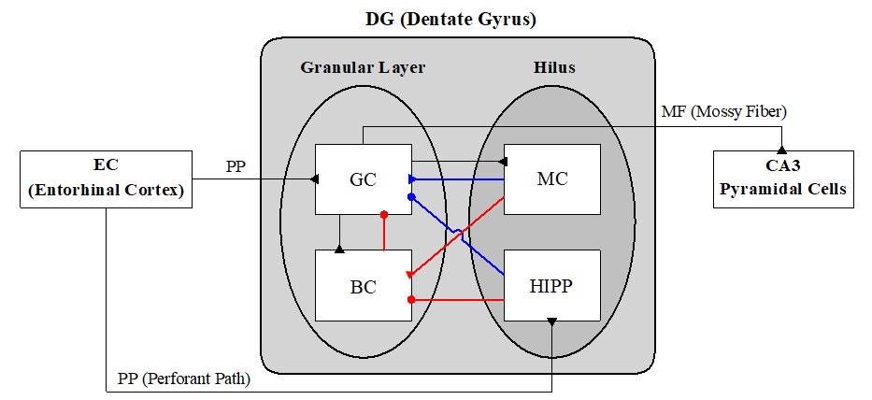
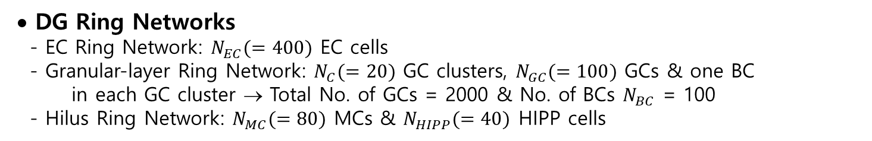
Hippocampal DG Network
• DG Network
- DG receives inputs from
the entorhinal cortex
(EC) via the perforant
paths (PPs)
- Granular Layer:
Excitatory granule cells
(GCs): providing the
output to the CA3 via
the mossy fibers (MFs)
Inhibitory basket cells
(BCs)
- Hilus: Excitatory mossy cells (MCs) & Inhibitory hilar perforant path-associated (HIPP) cells
- Disynaptic connections on GCs (Red lines) mediated by BCs:
MC → BC → GC & HIPP → BC → GC
- Monosynaptic connections on GCs (Blue lines):
MC → GC & HIPP → GC
• DG Ring Networks
- EC Ring Network: $N_{EC}(=400)$ EC cells
- Granular-layer Ring Network: $N_{C}(=20)$ GC clusters, $N_{GC}(=100)$ GCs & one BC
in each GC cluster → Total No. of GCs = 2000 & No. of BCs $N_{BC}$ = 100
- Hilus Ring Network: $N_{MC}(=80)$ MCs & $N_{HIPP}(=40)$ HIPP cells
2

Slide 3
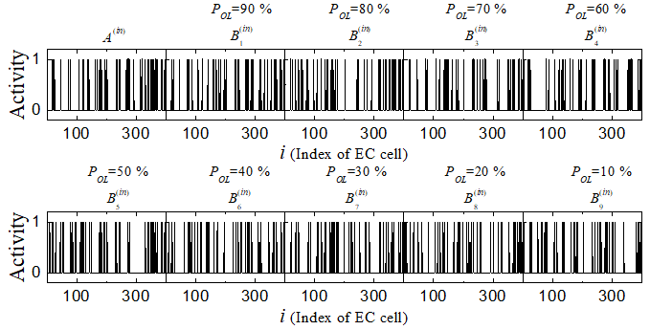
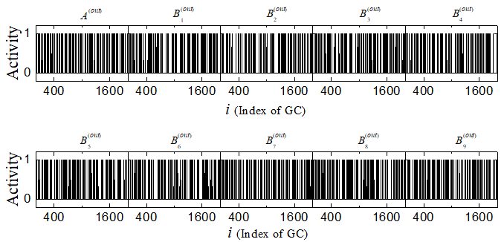

Binary Representation of Spiking Activity
• Binary Representation of
Spiking Activity of EC Cells
- Direct Excitatory EC Inputs via PP
Input density = 10 %
40 active EC cells
& Remaining ones: silent
Active EC cells: at least one spike
during the stimulus stage (1)
otherwise, silent EC cells (0)
- $A^{(in)}$ : Randomly-chosen input
pattern
Construct another input patterns $B_{i}^{(in)}$ from the with the overlap percentage $P_{OL}$
• Binary Representation of
Spiking Activity of GCs
Active GCs: at least one spike
during the stimulus stage (1)
otherwise, silent GCs (0)
3

Slide 4
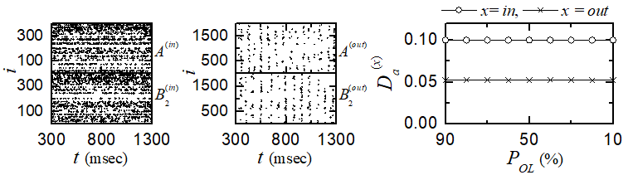
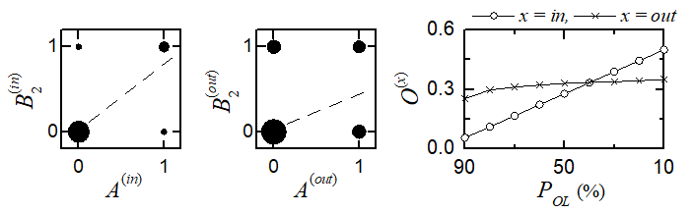
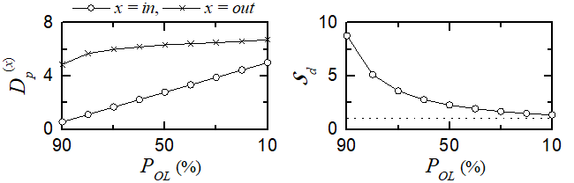

Characterization of Pattern Separation
• Activation Degrees
- GCs: More sparse firings than
EC cells
- Average activation degree:
$D_{a}^{\left(in\right)}$(=0.1) > $D_{a}^{\left(out\right)}$(=0.052)
• Orthogonalization Degrees
- Pearson’s correlation coefficient $ρ^{\left(x\right)}$:
denoting similarity degree
between two patterns
- Orthogonalization degree:
$O^{(x)}=(1−ρ^{\left(x\right)})/2; x =in, out$
representing dissimilarity degree between two patterns
$P_{OL}≥40\%$ → $O^{\left(out\right)}>O^{\left(in\right)}$, $P_{OL}<40\%$ → $O^{\left(in\right)}>O^{\left(out\right)}$
• Pattern Distance and Pattern Separation Degree
- Pattern distance: $𝒟_{p}^{(x)}=O^{(x)}/D_{a}^{(x)}$
- Pattern separation degree:
$𝒮_{d}=𝒟_{p}^{\left(out\right)}/𝒟_{p}^{\left(in\right)}$
$𝒮_{d}>1$ for all values of $P_{OL}$
→ Pattern separation occurs
4

Slide 5
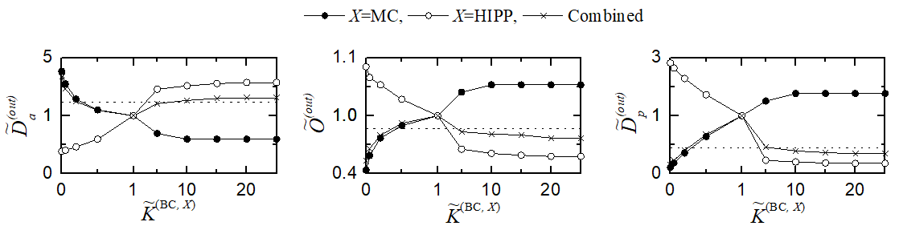
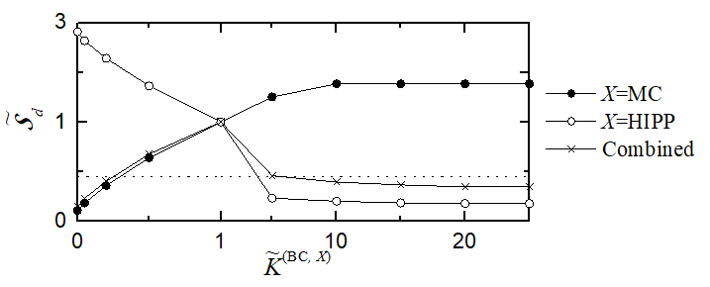
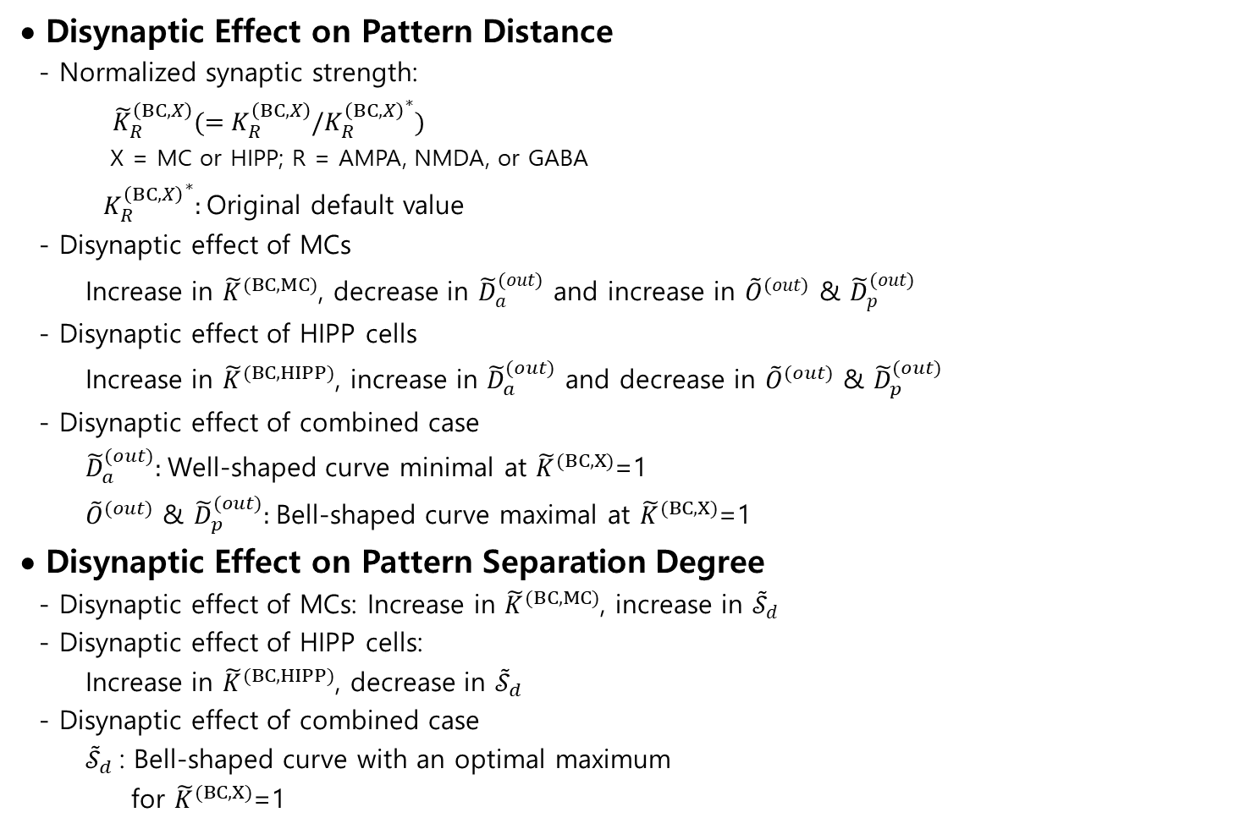
Disynaptic Effect on Pattern Separation
• Disynaptic Effect on Pattern Distance
- Normalized synaptic strength:
${\tilde{K}}_{R}^{\left(BC,X\right)}(=K_{R}^{\left(BC,X\right)}/{K_{R}^{\left(BC,X\right)}}^{∗})$
X = MC or HIPP; R = AMPA, NMDA, or GABA
${K_{R}^{\left(BC,X\right)}}^{∗}:$Original default value
- Disynaptic effect of MCs
Increase in ${\tilde{K}}^{(BC,MC)}$, decrease in ${\tilde{D}}_{a}^{(out)}$ and increase in ${\tilde{O}}^{(out)}$ & ${\tilde{D}}_{p}^{(out)}$
- Disynaptic effect of HIPP cells
Increase in ${\tilde{K}}^{(BC,HIPP)}$, increase in ${\tilde{D}}_{a}^{(out)}$ and decrease in ${\tilde{O}}^{(out)}$ & ${\tilde{D}}_{p}^{(out)}$
- Disynaptic effect of combined case
${\tilde{D}}_{a}^{(out)}:$Well-shaped curve minimal at ${\tilde{K}}^{(BC,X)}$=1
${\tilde{O}}^{(out)}$ & ${\tilde{D}}_{p}^{(out)}:$Bell-shaped curve maximal at ${\tilde{K}}^{(BC,X)}$=1
• Disynaptic Effect on Pattern Separation Degree
- Disynaptic effect of MCs: Increase in ${\tilde{K}}^{(BC,MC)}$, increase in ${\tilde{𝒮}}_{d}$
- Disynaptic effect of HIPP cells:
Increase in ${\tilde{K}}^{(BC,HIPP)}$, decrease in ${\tilde{𝒮}}_{d}$
- Disynaptic effect of combined case
${\tilde{𝒮}}_{d}$: Bell-shaped curve with an optimal maximum
for ${\tilde{K}}^{(BC,X)}$=1
5

Slide 6
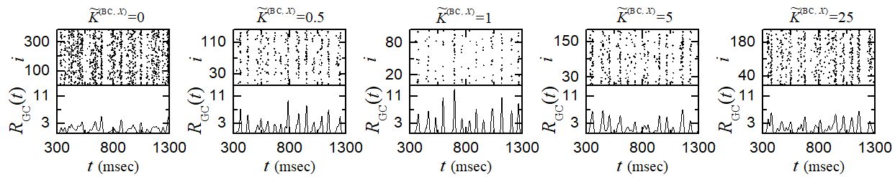
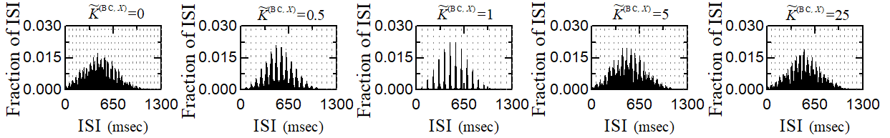
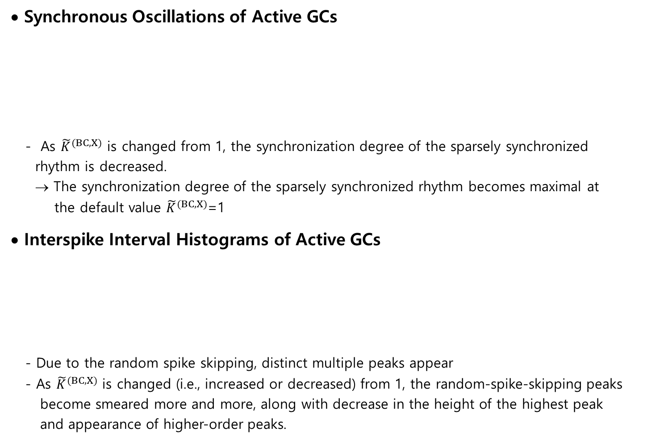
Sparsely Synchronized Rhythms of the Active GCs
• Synchronous Oscillations of Active GCs
- As ${\tilde{K}}^{(BC,X)}$ is changed from 1, the synchronization degree of the sparsely synchronized
rhythm is decreased.
→ The synchronization degree of the sparsely synchronized rhythm becomes maximal at
the default value ${\tilde{K}}^{(BC,X)}$=1
• Interspike Interval Histograms of Active GCs
- Due to the random spike skipping, distinct multiple peaks appear
- As ${\tilde{K}}^{(BC,X)}$ is changed (i.e., increased or decreased) from 1, the random-spike-skipping peaks
become smeared more and more, along with decrease in the height of the highest peak
and appearance of higher-order peaks.
6

Slide 7
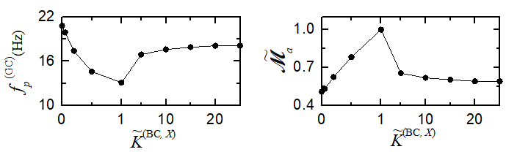
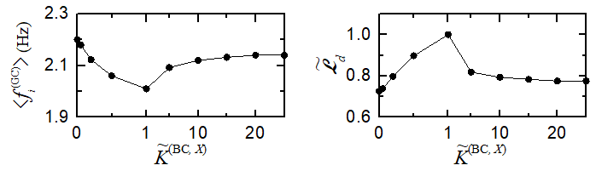
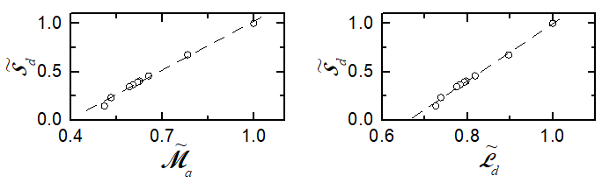

Relation between Sparsely Synchronized Rhythm and
Pattern Separation
• Population Behavior of GCs
- Population frequency $f_{p}^{(GC)}$: Well
shaped curve minimal at ${\tilde{K}}^{(BC,X)}$=1
- Synchronization degree ${\tilde{ℳ}}_{a}$: Bell
shaped curve minimal at ${\tilde{K}}^{(BC,X)}$=1
• Individual Behavior
- Population-averaged mean firing rate:
Well shaped curve
- Random phase-locking degree ${\tilde{ℒ}}_{d}$:
Denoting how well intermittent
spikes make phase-locking to
$R_{GC}(t)$ at random multiples of its global period → Bell shaped curve minimal at ${\tilde{K}}^{(BC,X)}$=1
• Relation between Sparsely Synchronized Rhythm and Pattern Separation
- Positive correlation between ${\tilde{𝒮}}_{d}$and ${\tilde{ℳ}}_{a}$
$r=0.9959$
- Positive correlation between ${\tilde{𝒮}}_{d}$ and ${\tilde{ℒ}}_{d}$
$r=0.9975$
7

Slide 8
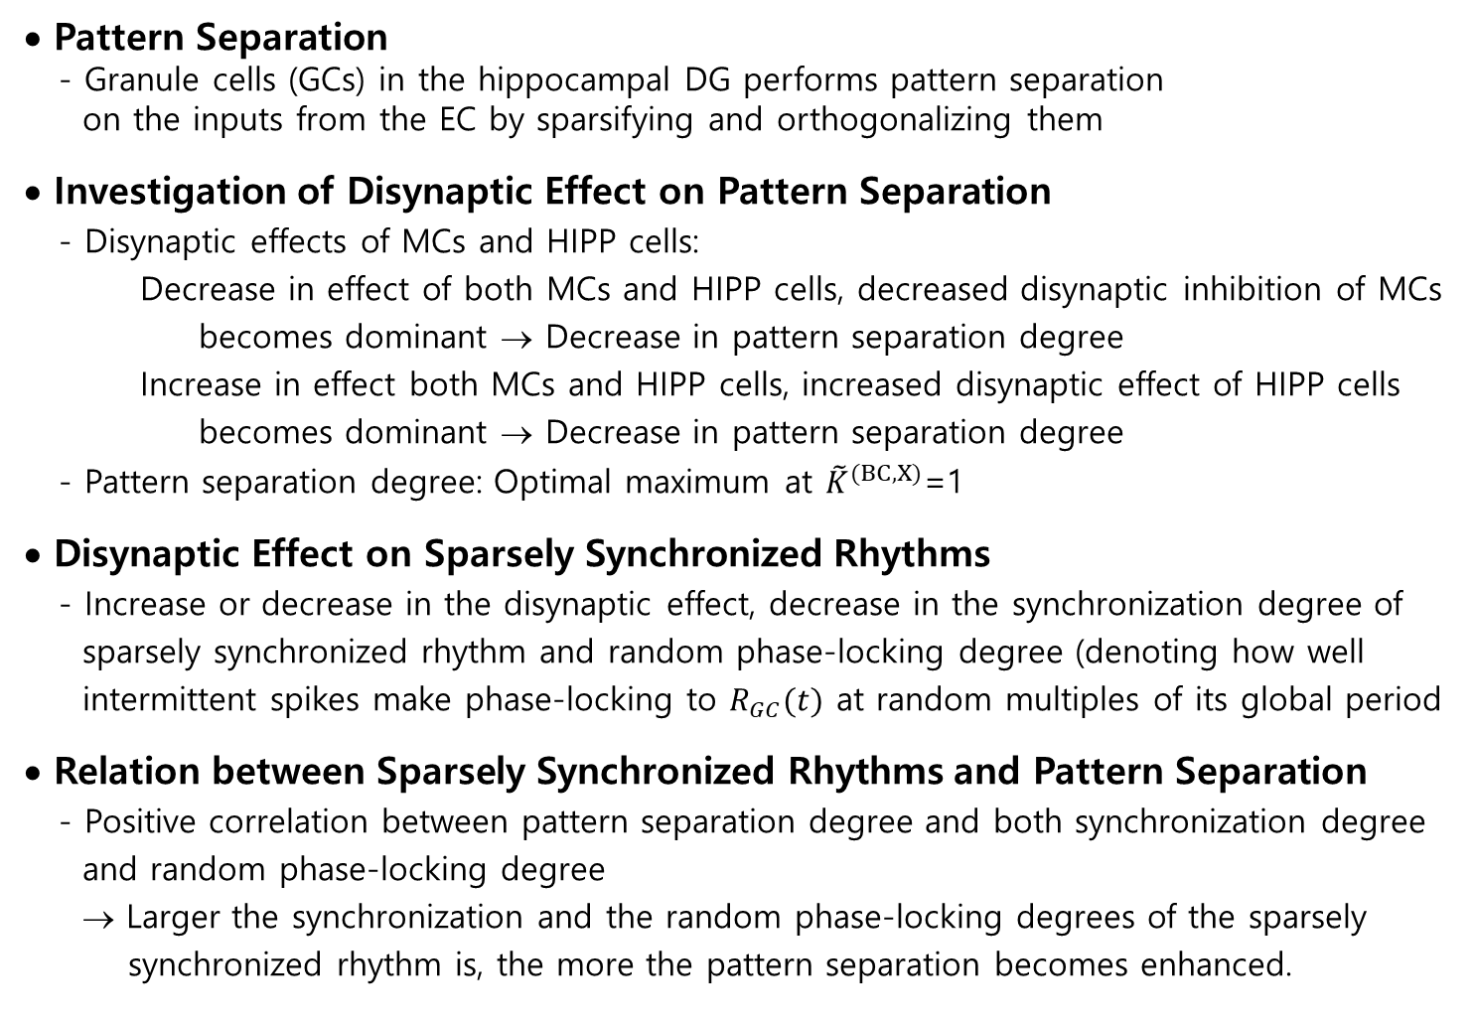
Summary
• Pattern Separation
- Granule cells (GCs) in the hippocampal DG performs pattern separation
on the inputs from the EC by sparsifying and orthogonalizing them
• Investigation of Disynaptic Effect on Pattern Separation
- Disynaptic effects of MCs and HIPP cells:
Decrease in effect of both MCs and HIPP cells, decreased disynaptic inhibition of MCs
becomes dominant → Decrease in pattern separation degree
Increase in effect both MCs and HIPP cells, increased disynaptic effect of HIPP cells
becomes dominant → Decrease in pattern separation degree
- Pattern separation degree: Optimal maximum at ${\tilde{K}}^{(BC,X)}$=1
• Disynaptic Effect on Sparsely Synchronized Rhythms
- Increase or decrease in the disynaptic effect, decrease in the synchronization degree of
sparsely synchronized rhythm and random phase-locking degree (denoting how well
intermittent spikes make phase-locking to $R_{GC}(t)$ at random multiples of its global period
• Relation between Sparsely Synchronized Rhythms and Pattern Separation
- Positive correlation between pattern separation degree and both synchronization degree
and random phase-locking degree
→ Larger the synchronization and the random phase-locking degrees of the sparsely
synchronized rhythm is, the more the pattern separation becomes enhanced.
8

