Slide 1


Robust Classification under Structural Sparsity in
A Hippocampus-Inspired Artificial Neural Network
Sang-Yoon Kim and Woochang Lim
Institute for Computational Neuroscience, Daegu National University of Education
http://www.icn.re.kr/
2026 KPS Spring Meeting
Notes:
We ask whether our hippocampus-inspired ANN exhibits Robust and Efficient performance under Structural Sparsity.

Slide 2
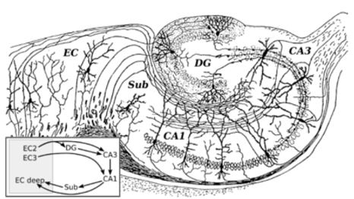
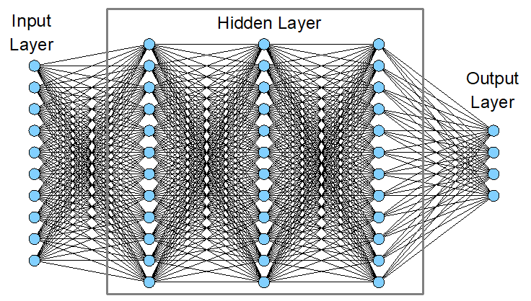
Motivation and Central Question
Motivation: Why Study Structural Sparsity?
Biological Hippocampus
(Evolved over hundreds of millions of years across vertebrate species
for efficient memory processing)
Sparse and Structured Architecture:
o Competitive sparsification in DG
o Recurrent stabilization in CA3
o Integrative refining in CA1
• Conventional ANN (CANN)
o Feedforward multilayer perceptron (MLP)
o Robustness typically relies on dense connectivity
Hippocampus
CANN
Central Question:
Do hippocampal circuit principles yield robust classification as connectivity becomes sparse?
Notes:
Biological hippocampus has evolved over hundreds of millions of years across vertebrate species and provides a sparse and structured architecture for efficient memory processing. Motivated by these principles,
we investigate a hippocampus-inspired artificial neural network. Biological hippocampus operates with sparse and structured wiring, whereas conventional MLPs rely on dense feedforward connectivity.
We ask whether structured sparsity can improve robustness.

Slide 3
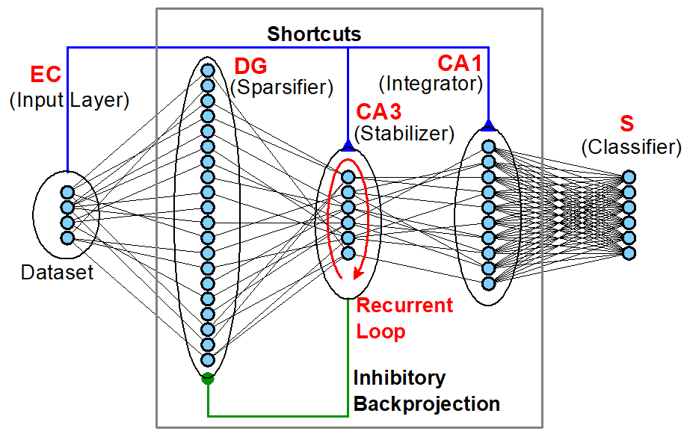
Architectures: OurANN vs CANN
OurANN: Hybrid Classifier Integrating:
(a) Hippocampus-Inspired Modular Architecture with Cooperative Functional Modules and (b) Engineering Machine Learning
3 Functional Modules: DG, CA3, CA1
• EC (input layer) → DG → CA3 → CA1 → S (output classifier)
• DG: competitive sparsification
• CA3: recurrent stabilization (temporal recurrence)
• CA1: integrative refinement
• Shortcut connections: EC→CA3, EC→CA1: direct input supply
• Inhibitory backprojection: CA3→DG: enhanced sparsification
• Population sizes: DG : CA3 : CA1 = 100 : 30 : 50 (anatomical ratio)
OurANN (Hippocampus-Inspired ANN)
CANN (Conventional ANN: Baseline)
3 Hidden Layers
• Input → Hidden → Hidden → Hidden → Output
• Same unit counts: 100 : 30 : 50
Notes:
OurANN: Hybrid Classifier Integrating (a) biological hippocampus-inspired Modular Architecture with Cooperative Functional Modules and (b) Engineering Machine. 3 Functional Modules (DG, CA3, CA1)
along with Shortcuts and Inhibitory Backprojection; Temporal recurrence in CA3 mimics time-evolution of spatially recurrent interactions in biological CA3. In contrast, the CANN consists of the three
standard hidden layers.

Slide 4
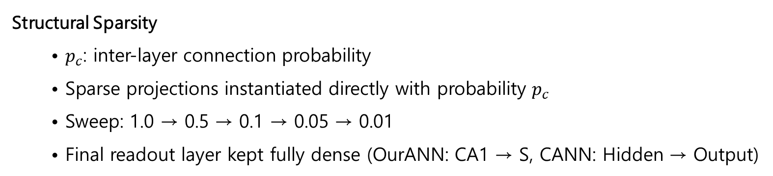
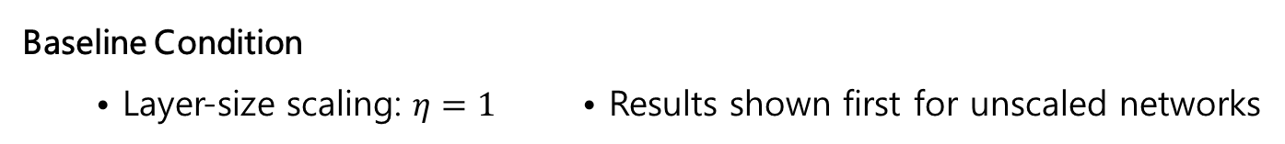
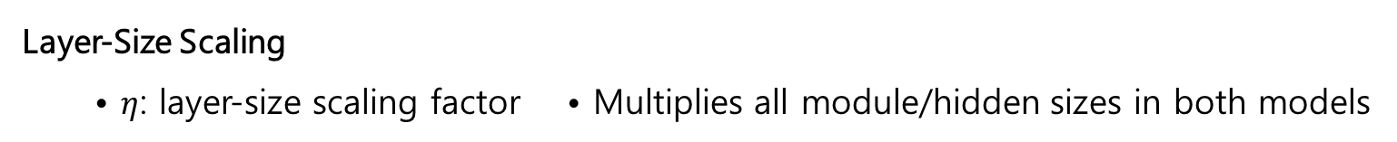
Computational Setup and Sparsity Control
Input Dataset: • MNIST handwritten digits (0-9)
• 28 × 28 grayscale images → 784-D flattened vector input to EC • 10-class classification
Training Protocol: • Supervised Machine Learning
• Identical training schedule for both models • Multiple random realizations
Structural Sparsity
• $p_{c}$: inter-layer connection probability
• Sparse projections instantiated directly with probability $p_{c}$
• Sweep: 1.0 → 0.5 → 0.1 → 0.05 → 0.01
• Final readout layer kept fully dense (OurANN: CA1 → S, CANN: Hidden → Output)
Layer-Size Scaling
• $η$: layer-size scaling factor • Multiplies all module/hidden sizes in both models
Baseline Condition
• Layer-size scaling: $η=1$ • Results shown first for unscaled networks
Notes:
We instantiate sparse connectivity directly using $p_{c}$, and apply the same training schedule and sparsification procedure to both models.

Slide 5
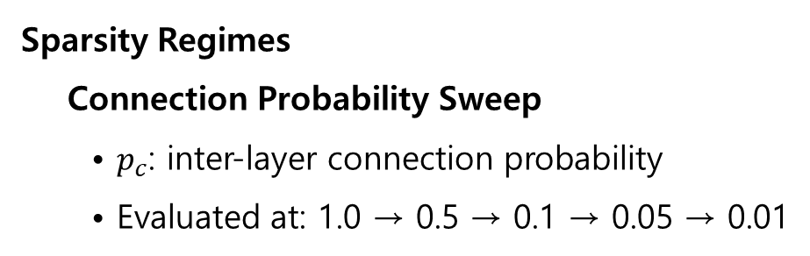
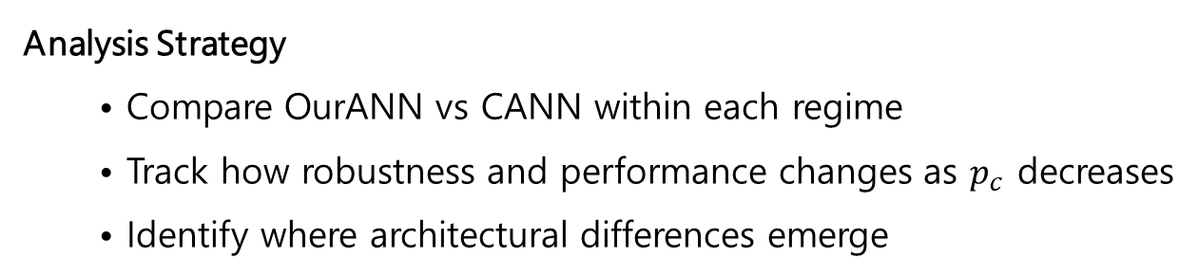
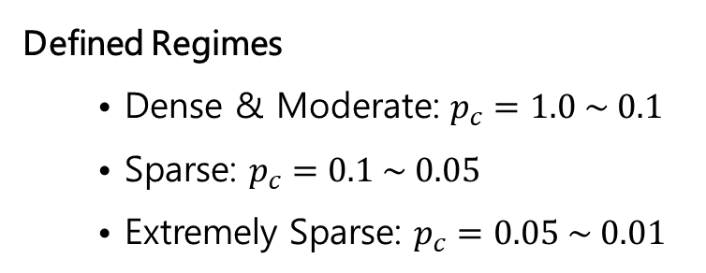
Computational Setup and Sparsity Control – Continued
Sparsity Regimes
Connection Probability Sweep
• $p_{c}$: inter-layer connection probability
• Evaluated at: 1.0 → 0.5 → 0.1 → 0.05 → 0.01
Defined Regimes
• Dense & Moderate: $p_{c}=1.0 \sim 0.1$
• Sparse: $p_{c}=0.1 \sim 0.05$
• Extremely Sparse: $p_{c}=0.05 \sim 0.01$
Analysis Strategy
• Compare OurANN vs CANN within each regime
• Track how robustness and performance changes as $p_{c}$ decreases
• Identify where architectural differences emerge
Notes:
We divide the sweep into dense/moderate, sparse, and extremely sparse regimes to identify where hippocampus-inspired architecture begins to confer an advantage.

Slide 6
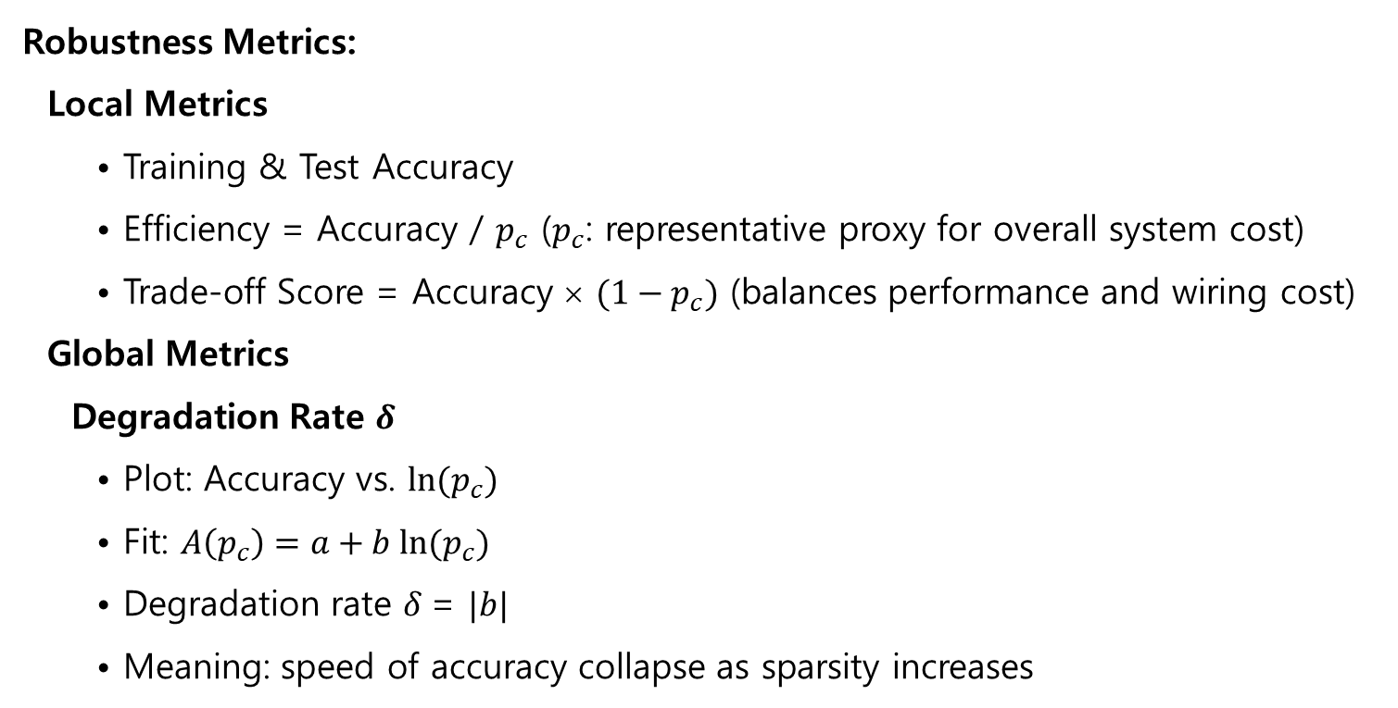
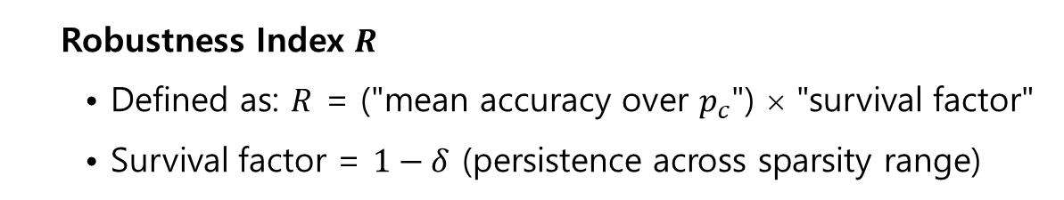
Robustness Metrics
Robustness Metrics:
Local Metrics
• Training & Test Accuracy
• Efficiency = Accuracy / $p_{c}$ ($p_{c}$: representative proxy for overall system cost)
• Trade-off Score = Accuracy × $(1−p_{c})$ (balances performance and wiring cost)
Global Metrics
Degradation Rate $δ$
• Plot: Accuracy vs. $ln(p_{c})$
• Fit: $A\left(p_{c}\right)=a+b ln(p_{c})$
• Degradation rate $δ$= $|b|$
• Meaning: speed of accuracy collapse as sparsity increases
Robustness Index $R$
• Defined as: $R$ = ("mean accuracy over $p_{c}$") × "survival factor"
• Survival factor = $1−δ$ (persistence across sparsity range)
Notes:
Local metrics capture performance and cost at each sparsity level, while global metrics quantify collapse speed and overall survival as connectivity decreases.

Slide 7
Results I: Global Robustness across Sparsity Regimes
Structural Robustness Emerges Under Increasing Sparsity
Main Message: OurANN degrades more slowly and maintains higher robustness than CANN
when connectivity becomes sparse.
Test-based Degradation Rate ($δ$) and Robustness Index ($R$); values shown as: $(δ,R)$ :
Model | Dense/Moderate (1.0~0.1) | Sparse (0.1~0.05) | Extremely Sparse (0.05~0.01)
OurANN | (0.0101, 0.9631) | (0.0302, 0.9175) | (0.0431, 0.8703)
CANN | (0.0105, 0.9637) | (0.0415, 0.9034) | (0.3466, 0.5023)
Interpretation
Dense / Moderate: The two models are essentially indistinguishable.
Sparse: OurANN begins to degrade more slowly than CANN.
Extremely Sparse: OurANN maintains structural robustness, while CANN collapses rapidly.
Notes:
“This table summarizes robustness using two global metrics: degradation rate and robustness index.”
“In dense regimes, the models behave similarly.”
“As sparsity increases, architectural differences emerge.”
“In the extremely sparse regime, CANN sharply degrades, while OurANN remains robust; at $p_{c}$ = 0.01, OurANN still achieves approximately 86% test accuracy, whereas CANN drops to around 36%.”

Slide 8
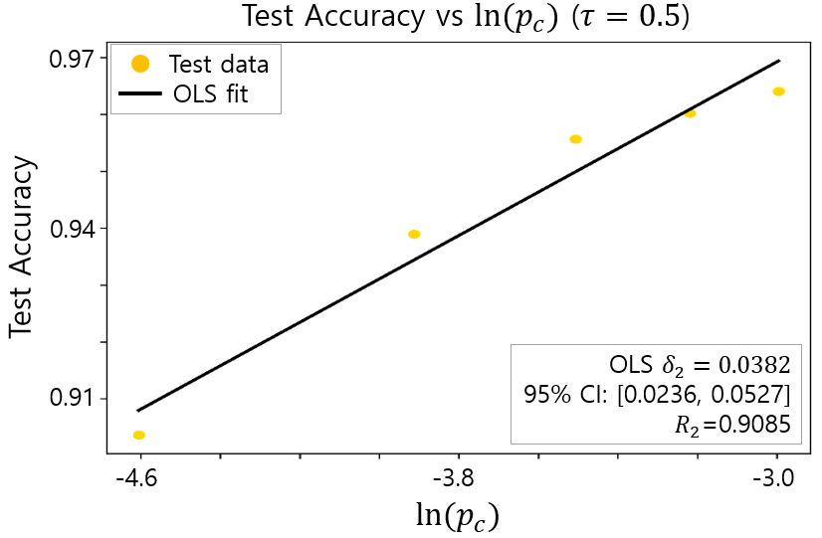
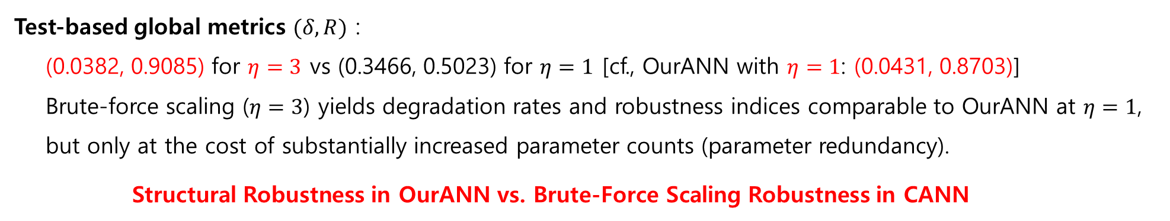
Results II: Limits of Brute-Force Scaling for CANN
Brute-Force Scaling for CANN with $η=3$in the case of extremely sparsity
Test-based global metrics $(δ,R)$ :
(0.0382, 0.9085) for $η=3$ vs (0.3466, 0.5023) for $η=1$ [cf., OurANN with $η=1$: (0.0431, 0.8703)]
Brute-force scaling ($η=3$) yields degradation rates and robustness indices comparable to OurANN at $η=1$,
but only at the cost of substantially increased parameter counts (parameter redundancy).
Structural Robustness in OurANN vs. Brute-Force Scaling Robustness in CANN
Notes:
The Figure focuses on brute-force scaling: with $η=3$, CANN reaches degradation rates and robustness indices similar to OurANN at baseline, but only by greatly increasing parameter counts

Slide 9
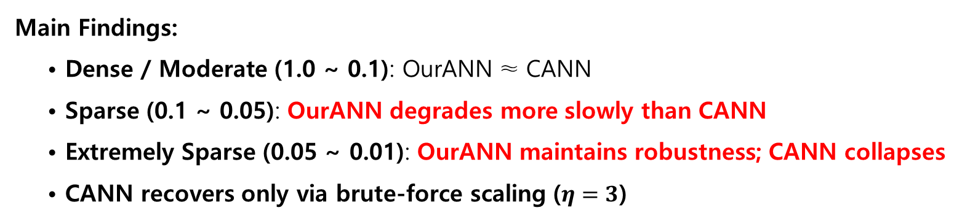
Conclusions
Main Findings:
• Dense / Moderate (1.0 ~ 0.1): OurANN ≈ CANN
• Sparse (0.1 ~ 0.05): OurANN degrades more slowly than CANN
• Extremely Sparse (0.05 ~ 0.01): OurANN maintains robustness; CANN collapses
• CANN recovers only via brute-force scaling ($η=3$)
Key Interpretation:
Emergent Structural Robustness vs Brute-Force Scaling Robustness
• Hippocampus-inspired architecture yields structural robustness under sparsity.
• Structural robustness emerges from cooperative dynamics among functional modules DG, CA3,
and CA1, supported by shortcuts and inhibitory backprojection.
• CANN relies on brute-force scaling via parameter expansion.
Future Works:
(1) Structural Robustness under Dataset Complexity; MNIST-Family → CIFAR-10/100 → ImageNet
(2) Dynamical Memory System: Extending OurANN beyond Classifier to A Dynamical Memory System
Notes:
We will test robustness under increasing Dataset Complexity: MNIST → F-MNIST / K-MNIST → EMNIST → CIFAR-10 / CIFAR-100 → ImageNet (with pretrained backbone)
Goal: Evaluate cooperative structural robustness vs brute-force scaling as task complexity increases. Future Work: Instead of ML, we consider a (biological) STDP learning in CA3, leading to classification.
🎤 Speaker Closing
“Under dense connectivity, architecture does not matter.” “Under sparsity, structure becomes decisive.” “OurANN achieves structural robustness through cooperative dynamics.”
“CANN requires brute-force expansion.” “Architecture matters under sparsity.”
OurANN exhibits emergent structural robustness arising from cooperative dynamics among DG, CA3, and CA1, further supported by shortcut connections and inhibitory backprojections.
To quantitatively characterize this property, we introduce novel global and local metrics for accuracy, efficiency, and robustness.

