Slide 1
Effect of The Adult-Born Immature Granule Cells on
The Winner-Take-All Competition in A Biological Network of
The Hippocampal Dentate Gyrus
S.-Y. Kim and W. Lim
Institute for Computational Neuroscience
Daegu National University of Education
• Hippocampus
- Consisting of the dentate gyrus (DG) and the areas CA3 and CA1
- Play a key role in memory formation, storage, and retrieval
• Pattern Separation
- Pattern Separation: Transforming input patterns into sparser and orthogonalized patterns
- DG: Pre-processor for the CA3: Granule cells (GCs) in the DG performs pattern separation,
facilitating pattern storage and retrieval in the CA3
- Sparsity → Enhancing the pattern separation
• Young Adult-Born Immature Granule Cells (imGCs)
- Young adult-born imGCs: High excitability (causing high activation) and low excitatory
innervation (reducing activation)
• Purpose of Our Study
Investigation of Effect of Adult-Born imGCs on Winner-Take-All (WTA)
Competition, Leading to Sparse Activity of the GCs in The Hippocampal
Dentate Gyrus
1

Slide 2
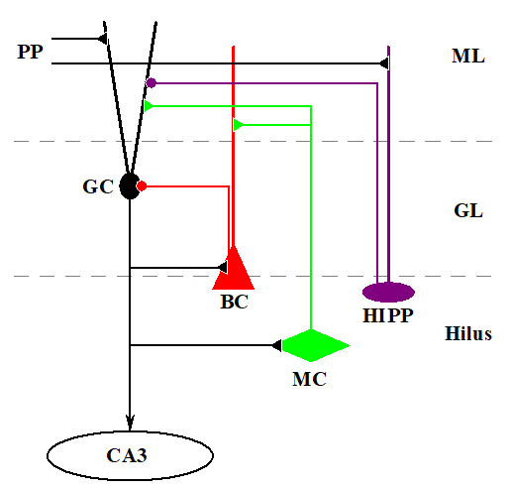
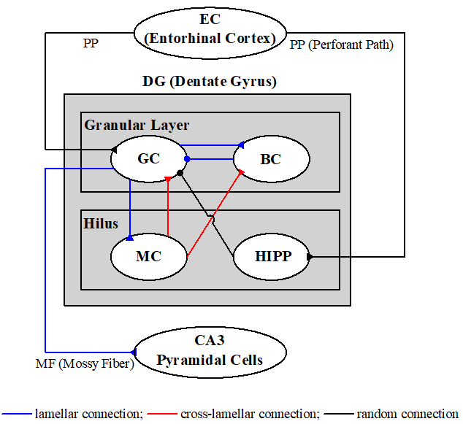
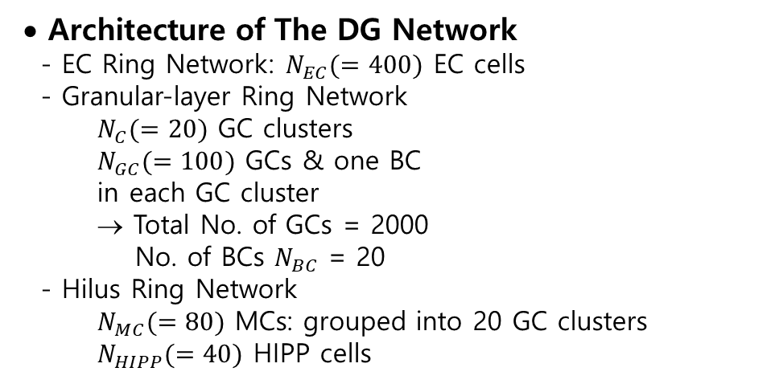
Hippocampal DG Network
• Cells in The DG Network
- DG receives inputs from the entorhinal cortex (EC)
via the perforant paths (PPs)
- Granular Layer:
Excitatory granule cells (GCs): providing the
output to the CA3 via the mossy fibers (MFs)
Inhibitory basket cells (BCs)
- Hilus:
Excitatory mossy cells (MCs)
Inhibitory hilar perforant path-associated (HIPP)
cells
• Architecture of The DG Network
- EC Ring Network: $N_{EC}(=400)$ EC cells
- Granular-layer Ring Network
$N_{C}(=20)$ GC clusters
$N_{GC}(=100)$ GCs & one BC
in each GC cluster
→ Total No. of GCs = 2000
No. of BCs $N_{BC}$ = 20
- Hilus Ring Network
$N_{MC}(=80)$ MCs: grouped into 20 GC clusters
$N_{HIPP}(=40)$ HIPP cells
2

Slide 3
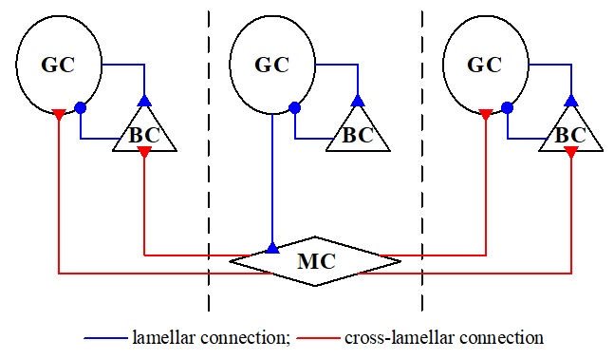
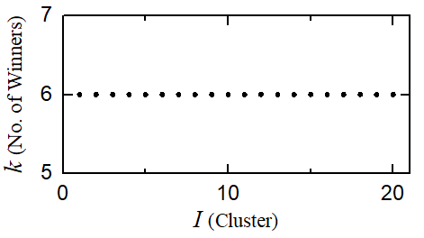
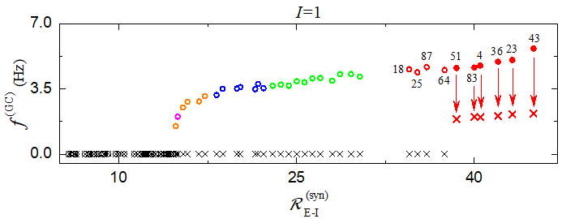

Winner-Take-All Competition in The Whole DG Network
• WTA Competition
- Occurrence of WTA competition through interaction of firing activity of the GCs with the
feedback inhibition of the BC.
- No. of active GCs = 120 → Activation degree of GCs =6 % (Sparse activation)
• I =1 GC Cluster
- $R_{E−I}^{(syn)}$: the ratio of No. of excitatory pre-synaptic EC cells $M_{syn}^{(GC,EC)}$ to No. of inhibitory pre-
synaptic HIPP cells $M_{syn}^{(GC,HIPP)}$
- 34 active GCs in the presence of
only the external excitatory EC
cells and inhibitory HIPP cells
→ 6 winner GCs in the hippocampal
DG network with only mGCs
3

Slide 4
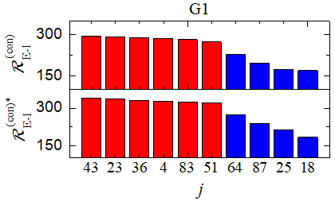
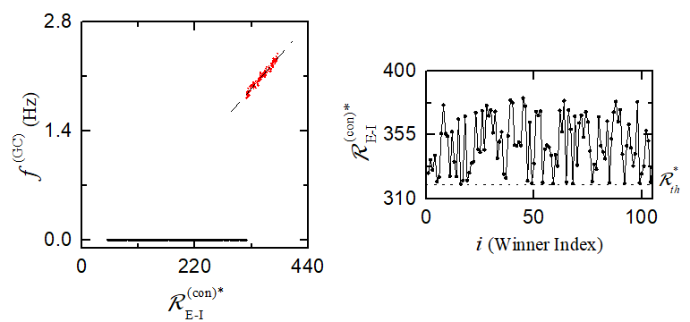
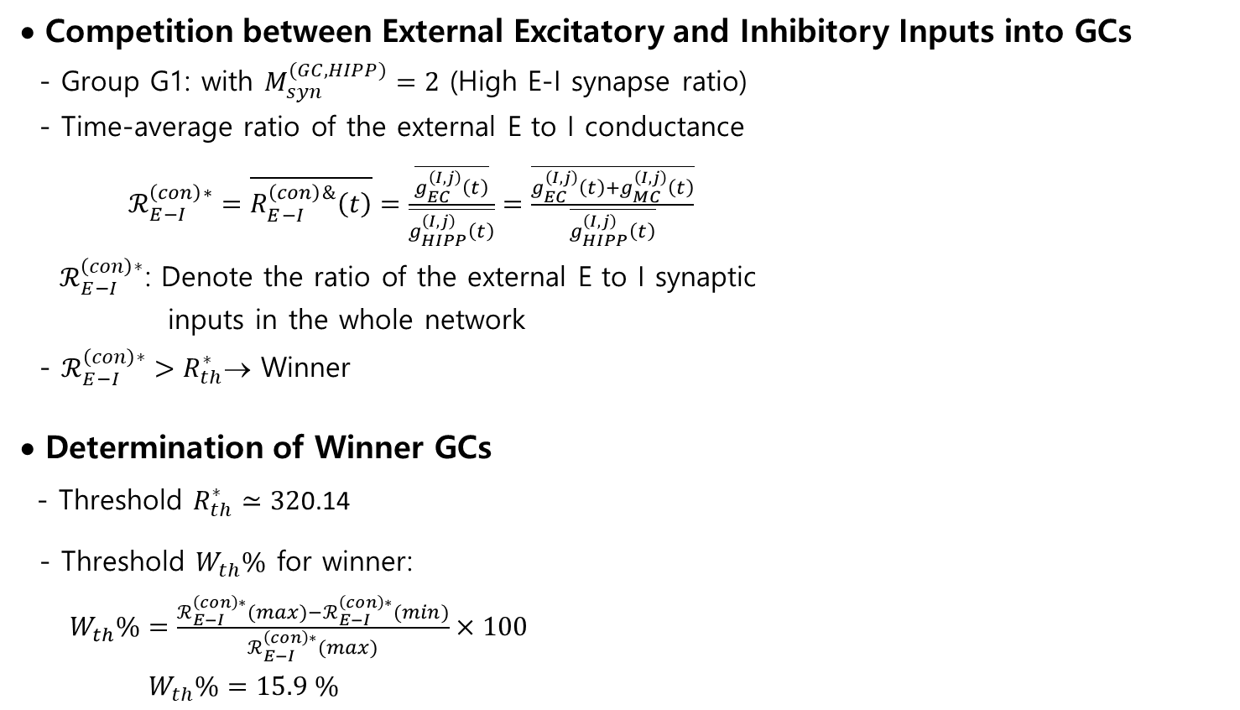
Dynamical Origin of WTA Competition
• Competition between External Excitatory and Inhibitory Inputs into GCs
- Group G1: with $M_{syn}^{(GC,HIPP)}=2$ (High E-I synapse ratio)
- Time-average ratio of the external E to I conductance
$ℛ_{E−I}^{\left(con\right)∗}=\overline{R_{E−I}^{\left(con\right)\&}\left(t\right)}=\frac{\overline{g_{EC}^{\left(I,j\right)}\left(t\right)}}{\overline{g_{HIPP}^{\left(I,j\right)}\left(t\right)}}=\frac{\overline{g_{EC}^{\left(I,j\right)}\left(t\right)+g_{MC}^{\left(I,j\right)}\left(t\right)}}{\overline{g_{HIPP}^{\left(I,j\right)}\left(t\right)}}$
$ℛ_{E−I}^{\left(con\right)∗}$: Denote the ratio of the external E to I synaptic
inputs in the whole network
- $ℛ_{E−I}^{\left(con\right)∗}>R_{th}^{∗}$→ Winner
• Determination of Winner GCs
- Threshold $R_{th}^{∗}≃32$0.14
- Threshold $W_{th}\%$ for winner:
$W_{th}\%=\frac{ℛ_{E−I}^{\left(con\right)∗}(max)−ℛ_{E−I}^{\left(con\right)∗}(min)}{ℛ_{E−I}^{\left(con\right)∗}(max)}×100$
$W_{th}\%=15.9 \%$
4

Slide 5
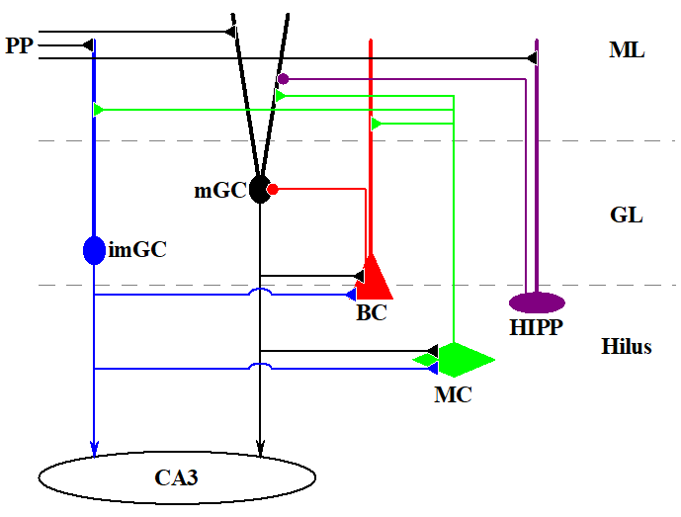
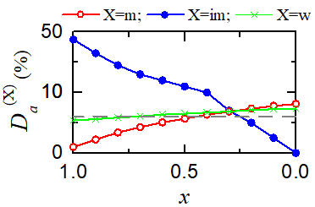
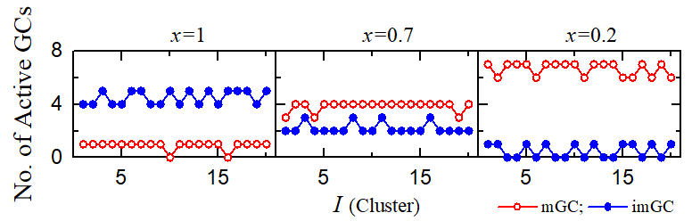

Effect of imGCs on The WTA Competition
• Hippocampal DG Network with imGCs & mGCs
- imGCs: High excitability, low excitatory innervation,
and no inhibitory inputs
- Fraction of imGCs: 10 % (mGCs: 90 %)
- Connection probability $p^{(imGC,X)}=20 x$% (0 ≤ $x$ ≤ 1)
• Activation Degree
- $x=1$: imGCs: High activation degree $D_{a}^{(im)}$(weakened
WTA competition) → Causing strong feedback
inhibition from the BCs to mGCs
→ Activation degree $D_{a}^{(m)}$ of mGCs: much decreased
(strengthened WTA competition)
In the whole heterogeneous population GCs, a little
strengthened WTA competition
- With decreasing from $x=1$ to 0, Rapid decrease of $D_{a}^{(im)}$
(strengthened WTA competition)
→ Increase in $D_{a}^{(m)}$ (weakened
WTA competition)
Whole heterogeneous population:
$D_{a}^{(w)}$: slowly increasing
(slowly decreasing WTA competition)
5

Slide 6
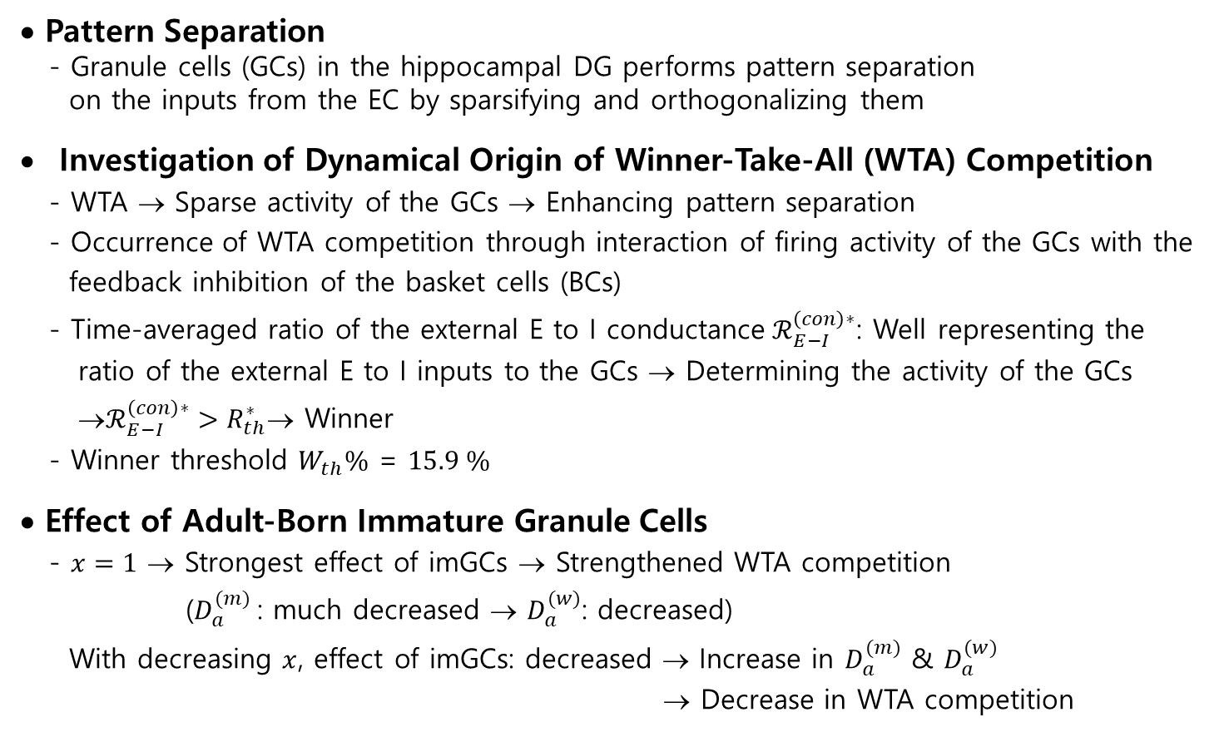
Summary
• Pattern Separation
- Granule cells (GCs) in the hippocampal DG performs pattern separation
on the inputs from the EC by sparsifying and orthogonalizing them
Investigation of Dynamical Origin of Winner-Take-All (WTA) Competition
- WTA → Sparse activity of the GCs → Enhancing pattern separation
- Occurrence of WTA competition through interaction of firing activity of the GCs with the
feedback inhibition of the basket cells (BCs)
- Time-averaged ratio of the external E to I conductance${ ℛ}_{E−I}^{\left(con\right)∗}$: Well representing the
ratio of the external E to I inputs to the GCs → Determining the activity of the GCs
→$ℛ_{E−I}^{\left(con\right)∗}>R_{th}^{∗}$→ Winner
- Winner threshold $W_{th}\%$ = $15.9 \%$
• Effect of Adult-Born Immature Granule Cells
- $x=1$ → Strongest effect of imGCs → Strengthened WTA competition
($D_{a}^{(m)}$: much decreased → $D_{a}^{(w)}$: decreased)
With decreasing $x$, effect of imGCs: decreased → Increase in $D_{a}^{(m)}$ & $D_{a}^{(w)}$
→ Decrease in WTA competition
6

