Slide 1
In-Vivo Firing Activities in A Spiking Neural Network of
The Basal Ganglia
S.-Y. Kim and W. Lim
Institute for Computational Neuroscience
Daegu National University of Education
• Basal Ganglia (BG)
BG: A group of subcortical deep-lying nuclei (“dark basement” of the brain)
- A variety of functions for motor and cognition
- Control of voluntary movement
- Important roles in cognitive processes (e.g., action selection, motor planning)
- Dysfunction:
e.g., Parkinson’s disease (PD) (neurodegenerative disease):
Motor deficits such as slowed movement (bradykinesia), rigidity, and tremor
Cognitive deficit: dementia
• Purpose of Our Study
Studying in-vivo firing activities in a spiking neural network of the
BG, composed of the striatal cells (D1/D2 SPNs) and the STNs (input nuclei),
the SNr (output nucleus), and the GP (intermediate control nucleus)
1

Slide 2
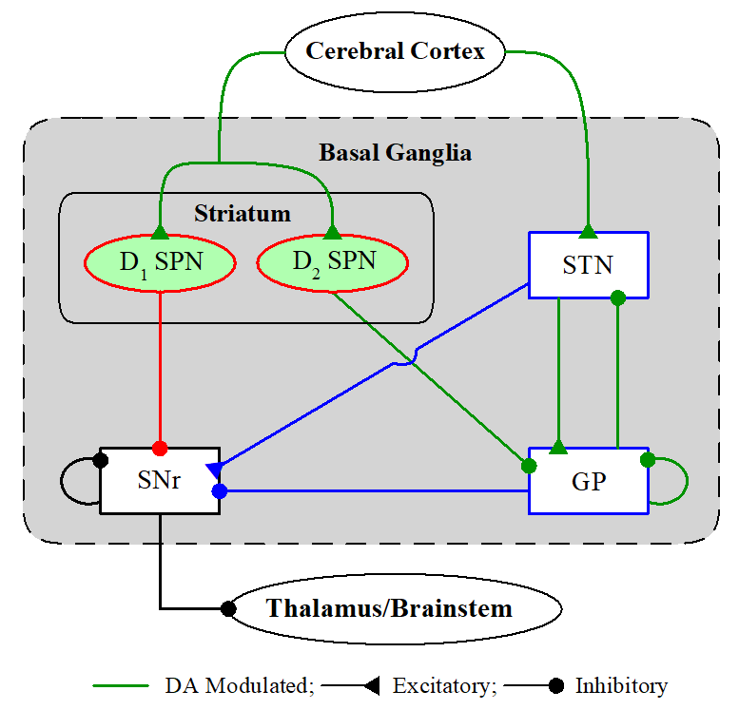
Spiking Neural Network (SNN) of The BG
BG: a collection of subcortical nuclei
[DA (dopamine) modulated: green color]
• Input Nuclei
- Striatum (principal input to the BG)
spiny projection neurons (SPNs)
with D1/D2 receptors for the DA
- STN (subthalamic nucleus)
only excitatory nucleus in the BG
• Output Nuclei
- SNr (substantia nigra pars reticulate)
• Intermediate Control Nucleus
- GP (globus pallidus external segment)
D1 SPNs project inhibition directly to the output nuclei SNr via the direct (“GO”) pathway. On the other hand, D2 SPNs are connected to the SNr via the indirect (“No-GO”) pathway crossing the GP and the STN.
BG: modulating and gating action selection via balance between the Go and No-Go
pathways → action selection device (gearbox in an auto)
2

Slide 3
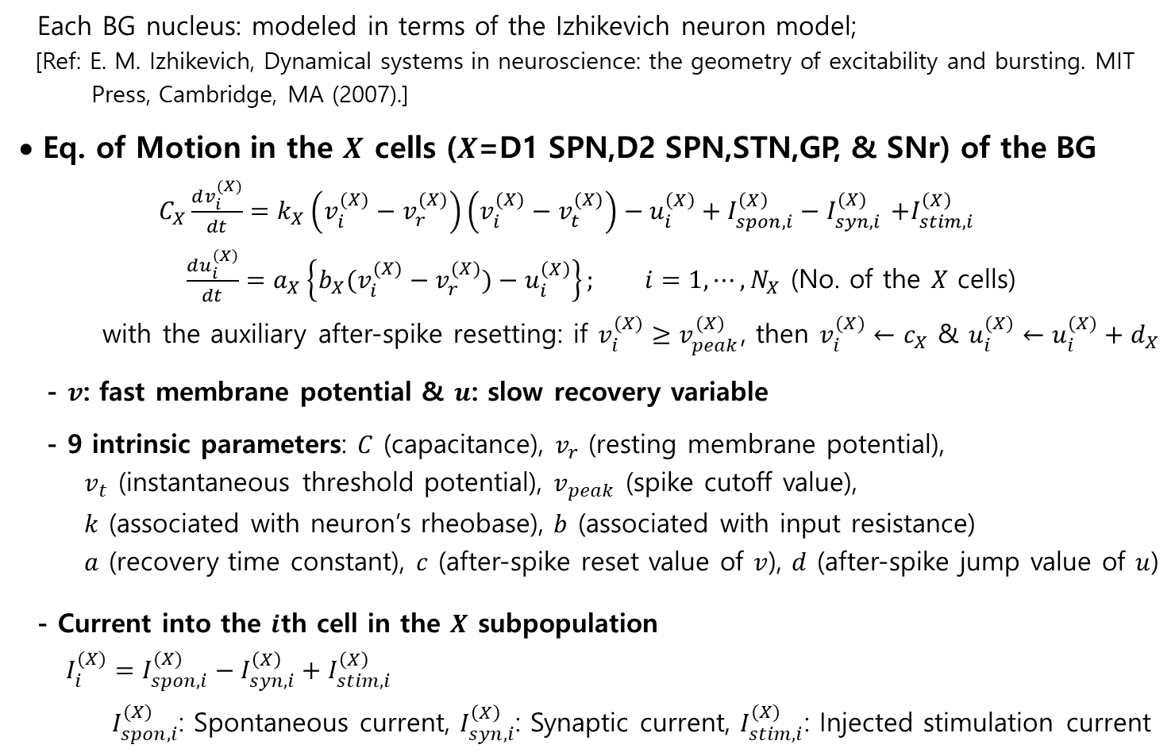
Governing Equation for The Population Dynamics of The BG
Each BG nucleus: modeled in terms of the Izhikevich neuron model;
[Ref: E. M. Izhikevich, Dynamical systems in neuroscience: the geometry of excitability and bursting. MIT
Press, Cambridge, MA (2007).]
• Eq. of Motion in the $X$ cells ($X$=D1 SPN,D2 SPN,STN,GP, & SNr) of the BG
$C_{X}\frac{dv_{i}^{(X)}}{dt}=k_{X}\left(v_{i}^{(X)}−v_{r}^{(X)}\right)\left(v_{i}^{(X)}−v_{t}^{(X)}\right)−u_{i}^{\left(X\right)}+I_{spon,i}^{\left(X\right)}−I_{syn,i}^{(X)}$ $+I_{stim,i}^{\left(X\right)}$
$\frac{du_{i}^{\left(X\right)}}{dt}=a_{X}\left\{b_{X}(v_{i}^{(X)}−v_{r}^{(X)})−u_{i}^{\left(X\right)}\right\}; i=1, ⋯, N_{X}$ (No. of the $X$ cells)
with the auxiliary after-spike resetting: if $v_{i}^{(X)}≥v_{peak}^{(X)}$, then $v_{i}^{(X)}←c_{X}$ & $u_{i}^{(X)}←u_{i}^{(X)}+d_{X}$
- $v$: fast membrane potential & $u$: slow recovery variable
- 9 intrinsic parameters: $C$ (capacitance), $v_{r}$ (resting membrane potential),
$v_{t}$ (instantaneous threshold potential), $v_{peak}$ (spike cutoff value),
$k$ (associated with neuron’s rheobase), $b$ (associated with input resistance)
$a$ (recovery time constant), $c$ (after-spike reset value of $v$), $d$ (after-spike jump value of $u$)
- Current into the $i$th cell in the $X$ subpopulation
$I_{i}^{(X)}=I_{spon,i}^{(X)}−I_{syn,i}^{\left(X\right)}+I_{stim,i}^{\left(X\right)}$
$I_{spon,i}^{(X)}$: Spontaneous current, $I_{syn,i}^{\left(X\right)}$: Synaptic current, $I_{stim,i}^{(X)}$: Injected stimulation current
3

Slide 4
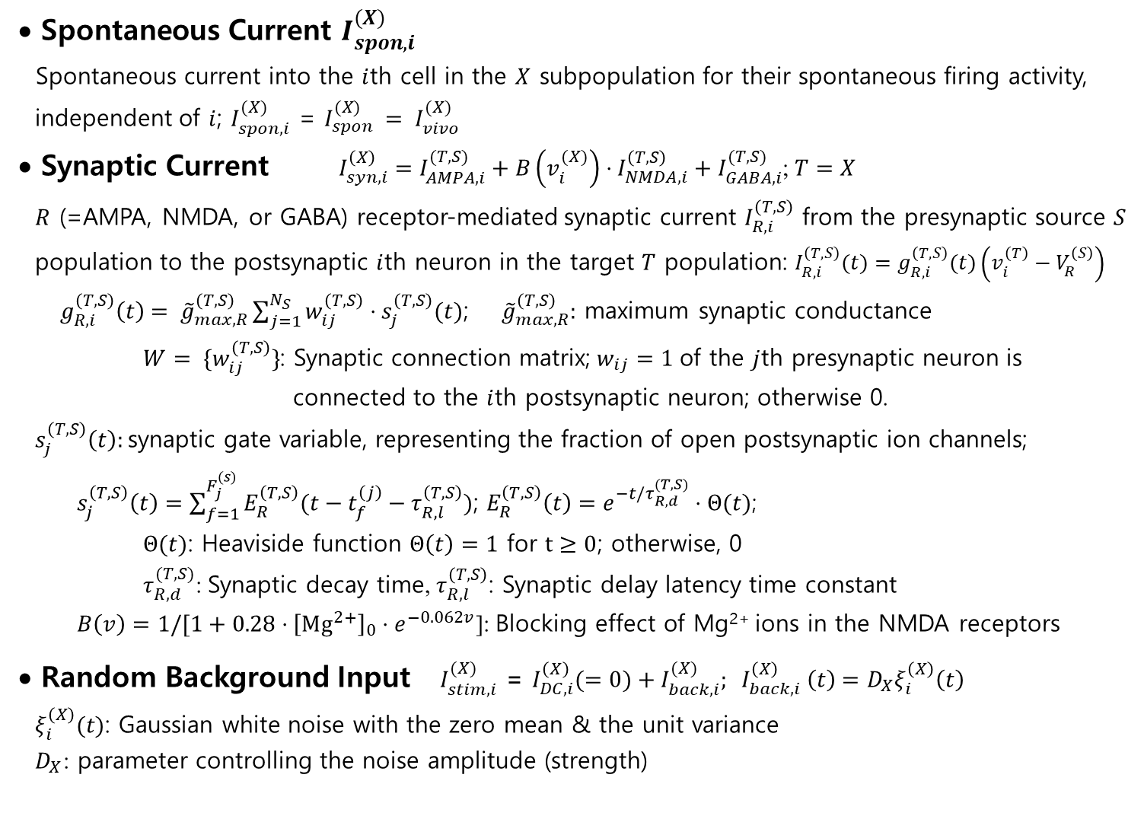
Current Sources for The In-Vivo Firing Activities
• Spontaneous Current $I_{spon,i}^{(X)}$
Spontaneous current into the $i$th cell in the $X$ subpopulation for their spontaneous firing activity,
independent of $i$; $I_{spon,i}^{(X)}$ = $I_{spon}^{(X)} = I_{vivo}^{(X)}$
• Synaptic Current $I_{syn,i}^{\left(X\right)}=I_{AMPA,i}^{(T,S)}+B\left(v_{i}^{(X)}\right)⋅I_{NMDA,i}^{\left(T,S\right)}+I_{GABA,i}^{(T,S)}$; $T=X$
$R$ (=AMPA, NMDA, or GABA) receptor-mediated synaptic current $I_{R,i}^{\left(T,S\right)}$ from the presynaptic source $S$
population to the postsynaptic $i$th neuron in the target $T$ population: $I_{R,i}^{\left(T,S\right)}(t)=g_{R,i}^{\left(T,S\right)}(t)\left(v_{i}^{\left(T\right)}−V_{R}^{\left(S\right)}\right)$
$g_{R,i}^{\left(T,S\right)}\left(t\right)= {\tilde{g}}_{max,R}^{\left(T,S\right)}\sum_{j=1}^{N_{S}}{w_{ij}^{\left(T,S\right)}⋅s_{j}^{\left(T,S\right)}(t)}$; ${\tilde{g}}_{max,R}^{\left(T,S\right)}:$ maximum synaptic conductance
$W= \{w_{ij}^{\left(T,S\right)}\}$: Synaptic connection matrix; $w_{ij}=1$ of the $j$th presynaptic neuron is
connected to the $i$th postsynaptic neuron; otherwise 0.
$s_{j}^{\left(T,S\right)}\left(t\right):$synaptic gate variable, representing the fraction of open postsynaptic ion channels;
$s_{j}^{\left(T,S\right)}\left(t\right)=\sum_{f=1}^{F_{j}^{(s)}}{E_{R}^{\left(T,S\right)}(t−t_{f}^{\left(j\right)}−τ_{R,l}^{\left(T,S\right)})}$; $E_{R}^{\left(T,S\right)}\left(t\right)=e^{−t/τ_{R,d}^{(T,S)}}⋅Θ(t)$;
$Θ(t)$: Heaviside function $Θ\left(t\right)=1$ for $t≥0$; otherwise, 0
$τ_{R,d}^{(T,S)}$: Synaptic decay time, $τ_{R,l}^{\left(T,S\right)}$: Synaptic delay latency time constant
$B\left(v\right)=1/[1+0.28⋅{\left[Mg^{2+}\right]}_{0}⋅e^{−0.062v}$]: Blocking effect of Mg²⁺ ions in the NMDA receptors
• Random Background Input $I_{stim,i}^{(X)}$ = $I_{DC,i}^{\left(X\right)}(=0)+I_{back,i}^{(X)}; I_{back,i}^{\left(X\right)} \left(t\right)=D_{X}ξ_{i}^{\left(X\right)}\left(t\right)$
$ξ_{i}^{\left(X\right)}(t)$: Gaussian white noise with the zero mean & the unit variance
$D_{X}$: parameter controlling the noise amplitude (strength)
4

Slide 5
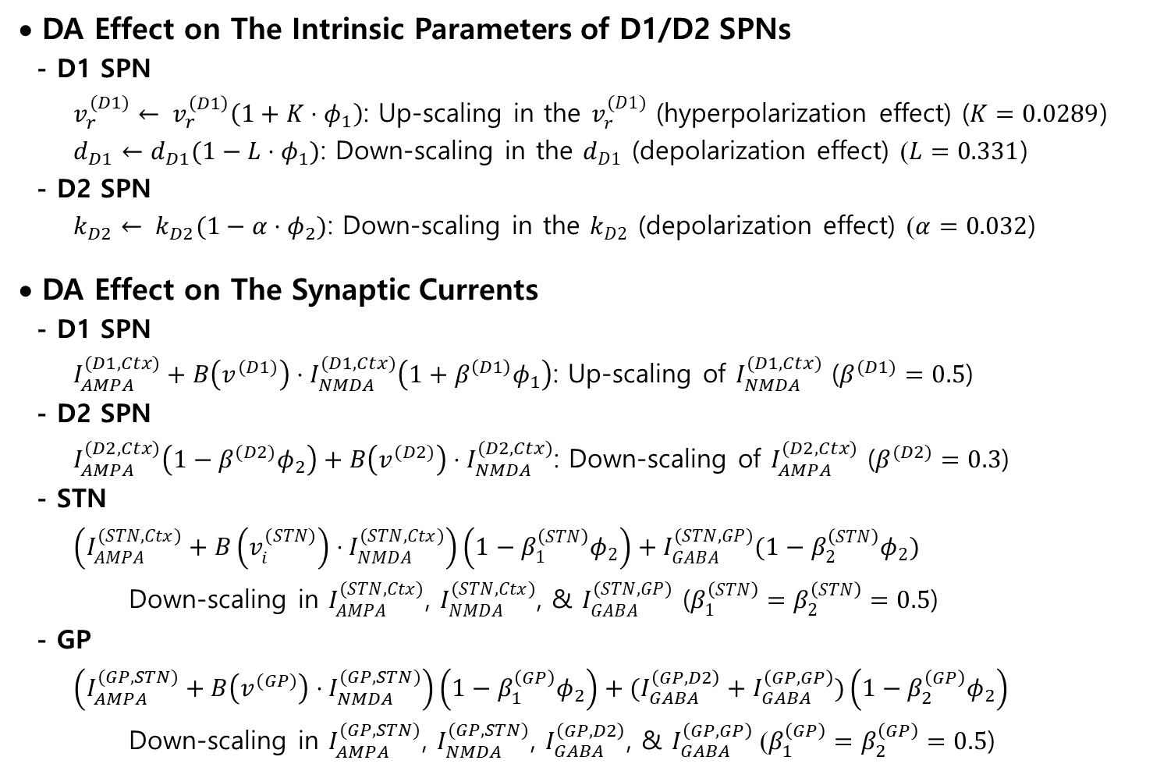
DA Modulation Effects
• DA Effect on The Intrinsic Parameters of D1/D2 SPNs
- D1 SPN
$v_{r}^{(D1)}← v_{r}^{\left(D1\right)}\left(1+K⋅φ_{1}\right)$: Up-scaling in the $v_{r}^{(D1)}$ (hyperpolarization effect) ($K=0.0289$)
$d_{D1}←d_{D1}(1−L⋅φ_{1})$: Down-scaling in the $d_{D1}$ (depolarization effect) ($L=0.331$)
- D2 SPN
$k_{D2}← k_{D2}(1−α⋅φ_{2})$: Down-scaling in the $k_{D2}$ (depolarization effect) ($α=0.032$)
• DA Effect on The Synaptic Currents
- D1 SPN
$I_{AMPA}^{(D1,Ctx)}+B\left(v^{(D1)}\right)⋅I_{NMDA}^{(D1,Ctx)}\left(1+β^{\left(D1\right)}φ_{1}\right)$: Up-scaling of $I_{NMDA}^{(D1,Ctx)}$ ($β^{(D1)}=0.5$)
- D2 SPN
$I_{AMPA}^{(D2,Ctx)}\left(1−β^{(D2)}φ_{2}\right)+B\left(v^{(D2)}\right)⋅I_{NMDA}^{(D2,Ctx)}$: Down-scaling of $I_{AMPA}^{(D2,Ctx)}$ ($β^{(D2)}=0.3$)
- STN
$\left(I_{AMPA}^{(STN,Ctx)}+B\left(v_{i}^{(STN)}\right)⋅I_{NMDA}^{(STN,Ctx)}\right)\left(1−β_{1}^{\left(STN\right)}φ_{2}\right)+I_{GABA}^{(STN,GP)}(1−β_{2}^{\left(STN\right)}φ_{2})$
Down-scaling in $I_{AMPA}^{(STN,Ctx)}$, $I_{NMDA}^{(STN,Ctx)}$, & $I_{GABA}^{(STN,GP)}$ ($β_{1}^{\left(STN\right)}=β_{2}^{\left(STN\right)}=0.5$)
- GP
$\left(I_{AMPA}^{(GP,STN)}+B\left(v^{(GP)}\right)⋅I_{NMDA}^{(GP,STN)}\right)\left(1−β_{1}^{\left(GP\right)}φ_{2}\right)+(I_{GABA}^{\left(GP,D2\right)}+I_{GABA}^{\left(GP,GP\right)})\left(1−β_{2}^{\left(GP\right)}φ_{2}\right)$
Down-scaling in $I_{AMPA}^{(GP,STN)}$, $I_{NMDA}^{(GP,STN)}$, $I_{GABA}^{\left(GP,D2\right)}$, & $I_{GABA}^{\left(GP,GP\right)}$ ($β_{1}^{\left(GP\right)}=β_{2}^{\left(GP\right)}=0.5$)
5

Slide 6
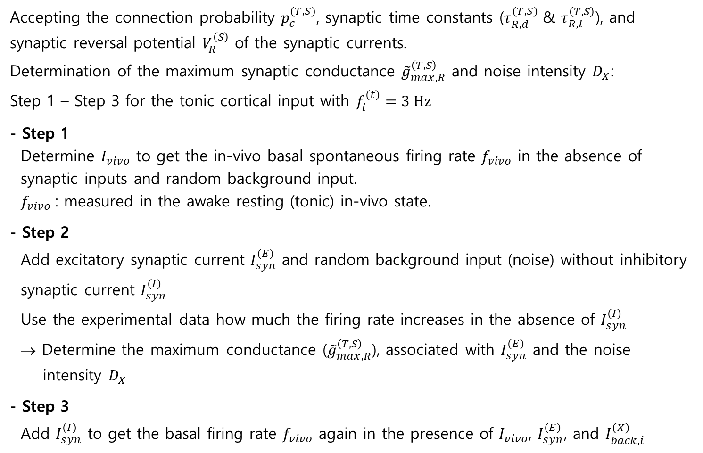
Procedures to Get Synaptic Conductance and Noise Intensity
Accepting the connection probability $p_{c}^{(T,S)}$, synaptic time constants ($τ_{R,d}^{(T,S)}$ & $τ_{R,l}^{\left(T,S\right)}$), and synaptic reversal potential $V_{R}^{\left(S\right)}$ of the synaptic currents.
Determination of the maximum synaptic conductance ${\tilde{g}}_{max,R}^{\left(T,S\right)}$ and noise intensity $D_{X}$:
Step 1 – Step 3 for the tonic cortical input with $f_{i}^{(t)}=3 Hz$
- Step 1
Determine $I_{vivo}$ to get the in-vivo basal spontaneous firing rate $f_{vivo}$ in the absence of
synaptic inputs and random background input.
$f_{vivo}$: measured in the awake resting (tonic) in-vivo state.
- Step 2
Add excitatory synaptic current $I_{syn}^{(E)}$ and random background input (noise) without inhibitory
synaptic current $I_{syn}^{(I)}$
Use the experimental data how much the firing rate increases in the absence of $I_{syn}^{(I)}$
→ Determine the maximum conductance (${\tilde{g}}_{max,R}^{\left(T,S\right)}$), associated with $I_{syn}^{(E)}$ and the noise
intensity $D_{X}$
- Step 3
Add $I_{syn}^{(I)}$ to get the basal firing rate $f_{vivo}$ again in the presence of $I_{vivo}$, $I_{syn}^{(E)}$, and $I_{back,i}^{\left(X\right)}$
6

Slide 7
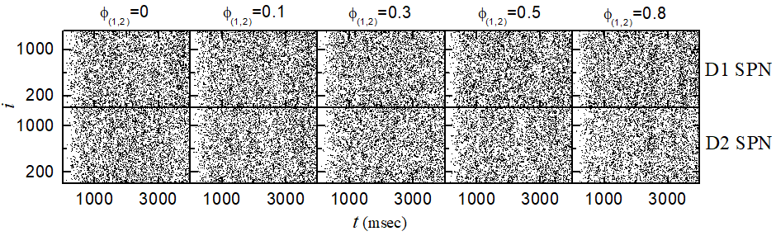
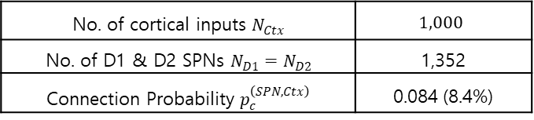

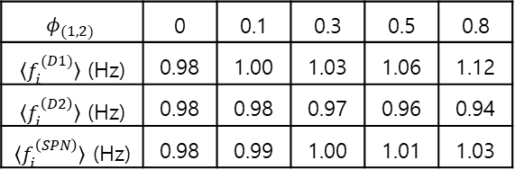
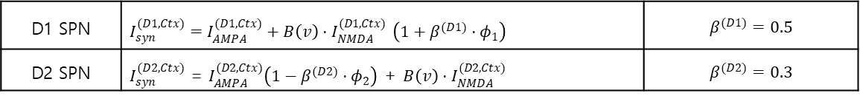
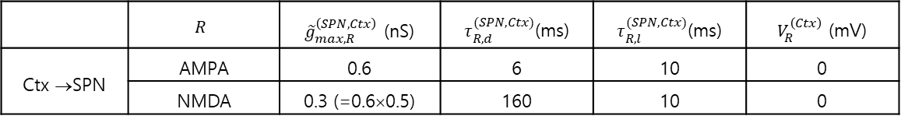
In-Vivo Firing Activities of the D1/D2 SPNs
• Current Source $I_{i}^{(SPN)}=−I_{syn,i}^{\left(SPN\right)}+I_{back,i}^{(SPN)}$
• Synaptic Inputs from the Cortex to the D1/D2 SPNs
$I_{syn,i}^{\left(SPN\right)}=I_{AMPA,i}^{(SPN,Ctx)}+B\left(v_{i}^{(SPN)}\right)⋅I_{NMDA,i}^{\left(SPN,Ctx\right)}$
- DA effect on the synaptic currents
• Noise-induced In-vivo Firings for $D_{SPN}^{∗}$=246
$〈f_{i}^{\left(SPN\right)}〉=1$ Hz for $φ_{(1,2)}=0.3$
No. of cortical inputs $N_{Ctx}$ | $$1,000$$
No. of D1 & D2 SPNs $N_{D1}=N_{D2}$ | 1,352
Connection Probability $p_{c}^{\left(SPN,Ctx\right)}$ | 0.084 (8.4%)
 | $$R$$ | ${\tilde{g}}_{max,R}^{\left(SPN,Ctx\right)}$ (nS) | $τ_{R,d}^{(SPN,Ctx)}$(ms) | $τ_{R,l}^{(SPN,Ctx)}$(ms) | $V_{R}^{\left(Ctx\right)}$ (mV)
Ctx →SPN | AMPA | 0.6 | 6 | 10 | 0
 | NMDA | 0.3 (=0.6×0.5) | 160 | 10 | 0
D1 SPN | $I_{syn}^{(D1,Ctx)}=I_{AMPA}^{(D1,Ctx)}+B\left(v\right)⋅I_{NMDA}^{(D1,Ctx)}$ $\left(1+β^{(D1)}⋅φ_{1}\right)$ | $$β^{(D1)}=0.5$$
D2 SPN | $I_{syn}^{(D2,Ctx)}$ = $I_{AMPA}^{(D2,Ctx)}\left(1−β^{(D2)}⋅φ_{2}\right)$ + $B\left(v\right)⋅I_{NMDA}^{(D2,Ctx)}$ | $$β^{(D2)}=0.3$$
$$φ_{(1,2)}$$ | 0 | 0.1 | 0.3 | 0.5 | 0.8
$〈f_{i}^{(D1)}〉$ (Hz) | 0.98 | 1.00 | 1.03 | 1.06 | 1.12
$〈f_{i}^{\left(D2\right)}〉$ (Hz) | 0.98 | 0.98 | 0.97 | 0.96 | 0.94
$〈f_{i}^{\left(SPN\right)}〉$ (Hz) | 0.98 | 0.99 | 1.00 | 1.01 | 1.03
7

Slide 8
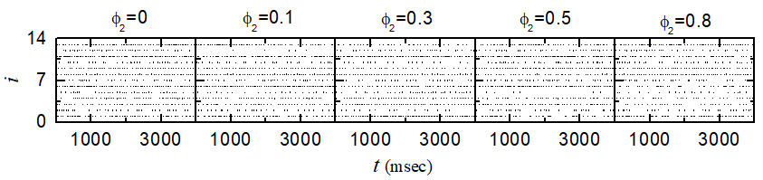
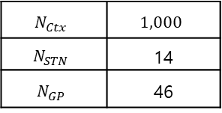
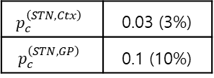

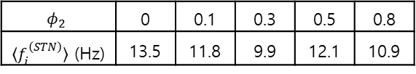
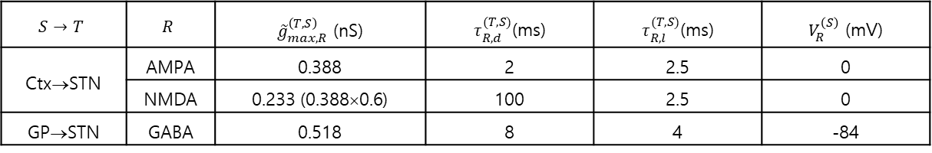
In-Vivo Firing Activities of the STN Cells
• Current Source $I_{i}^{(STN)}=I_{vivo}^{(STN)}−I_{syn,i}^{\left(STN\right)}+I_{back,i}^{(STN)}$; $I_{vivo}^{(STN)}=56.6 pA$ for $f_{vivo}^{(STN)}=9.9 Hz$
• Synaptic Inputs to the STN Cells and Random Background Input
- Excitatory synaptic inputs from cortex
$I_{syn,i}^{\left(STN,Ctx\right)}=I_{AMPA,i}^{(STN,Ctx)}+B\left(v_{i}^{(STN)}\right)⋅I_{NMDA,i}^{\left(STN,Ctx\right)}$
- Inhibitory synaptic inputs from GP $I_{syn,i}^{\left(STN,GP\right)}=I_{GABA,i}^{(STN,GP)}$
- DA effect on the synaptic currents
- Random background input: $D_{STN}^{∗}$=11.9
• In-vivo Firings for $D_{STN}^{∗}$=11.9
$〈f_{i}^{\left(STN\right)}〉=9.9$ Hz for $φ_{2}=0.3$
$$N_{Ctx}$$ | $$1,000$$
$$N_{STN}$$ | 14
$$N_{GP}$$ | 46
$$p_{c}^{\left(STN,Ctx\right)}$$ | 0.03 (3%)
$$p_{c}^{\left(STN,GP\right)}$$ | 0.1 (10%)
$$S→T$$ | $$R$$ | ${\tilde{g}}_{max,R}^{\left(T,S\right)}$ (nS) | $τ_{R,d}^{(T,S)}$(ms) | $τ_{R,l}^{(T,S)}$(ms) | $V_{R}^{\left(S\right)}$ (mV)
Ctx→STN | AMPA | 0.388 | 2 | 2.5 | 0
 | NMDA | 0.233 (0.388×0.6) | 100 | 2.5 | 0
GP→STN | GABA | 0.518 | 8 | 4 | -84
$$\left(I_{AMPA}^{(STN,Ctx)}+B\left(v_{i}^{(STN)}\right)⋅I_{NMDA}^{(STN,Ctx)}\right)\left(1−β_{1}^{\left(STN\right)}φ_{2}\right)+I_{GABA}^{(STN,GP)}(1−β_{2}^{\left(STN\right)}φ_{2})$$ | $$β_{1}^{\left(STN\right)}=β_{2}^{\left(STN\right)}=0.5$$
$$φ_{2}$$ | 0 | 0.1 | 0.3 | 0.5 | 0.8
$〈f_{i}^{\left(STN\right)}〉$ (Hz) | 13.5 | 11.8 | 9.9 | 12.1 | 10.9
8

Slide 9
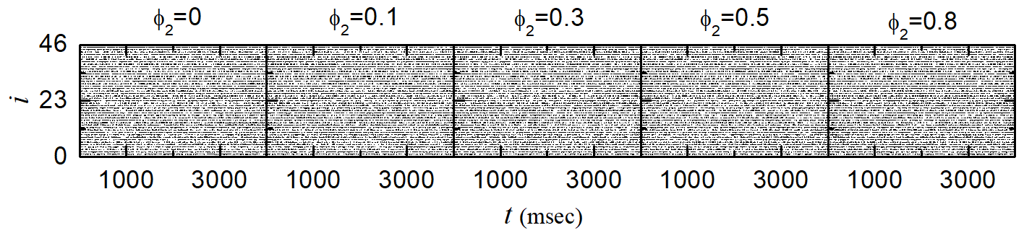
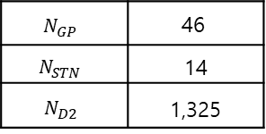
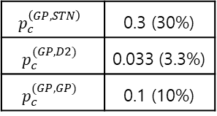

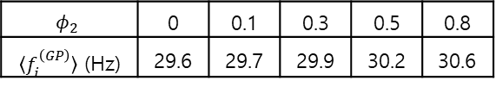
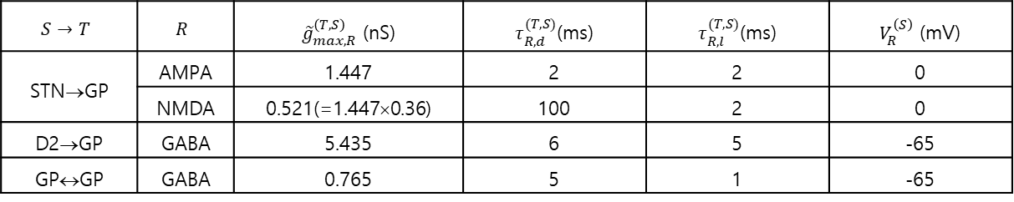
In-Vivo Firing Activities of the GP Cells
• Current Source $I_{i}^{(GP)}=I_{vivo}^{(GP)}−I_{syn,i}^{\left(GP\right)}+I_{back,i}^{(GP)}$; $I_{vivo}^{(GP)}=84.0 pA$ for $f_{vivo}^{(GP)}=29.9 Hz$
• Synaptic Inputs to the GP Cells and Random Background Input
- Excitatory synaptic inputs from STN
$I_{syn,i}^{\left(GP,STN\right)}=I_{AMPA,i}^{(GP,STN)}+B\left(v_{i}^{(GP)}\right)⋅I_{NMDA,i}^{\left(GP,STN\right)}$
- Inhibitory synaptic inputs from D2 SPN $I_{GABA,i}^{(GP,D2)}$and recurrent connections in GP cells $I_{GABA,i}^{(GP,GP)}$
- DA effect on the synaptic currents
- Random background input: $D_{GP}^{∗}$=267
• In-vivo Firings for $D_{GP}^{∗}$=267
$〈f_{i}^{\left(GP\right)}〉=29.9$ Hz for $φ_{2}=0.3$
$$N_{GP}$$ | $$\text{46}$$
$$N_{STN}$$ | 14
$$N_{D2}$$ | 1,325
$$p_{c}^{\left(GP,STN\right)}$$ | 0.3 (30%)
$$p_{c}^{(GP,D2)}$$ | 0.033 (3.3%)
$$p_{c}^{(GP,GP)}$$ | 0.1 (10%)
$$S→T$$ | $$R$$ | ${\tilde{g}}_{max,R}^{\left(T,S\right)}$ (nS) | $τ_{R,d}^{(T,S)}$(ms) | $τ_{R,l}^{(T,S)}$(ms) | $V_{R}^{\left(S\right)}$ (mV)
STN→GP | AMPA | 1.447 | 2 | 2 | 0
 | NMDA | 0.521(=1.447×0.36) | 100 | 2 | 0
D2→GP | GABA | 5.435 | 6 | 5 | -65
GP↔GP | GABA | 0.765 | 5 | 1 | -65
$$\left(I_{AMPA}^{(GP,STN)}+B\left(v_{i}^{(GP)}\right)⋅I_{NMDA}^{(GP,STN)}\right)\left(1−β_{1}^{\left(GP\right)}φ_{2}\right)+\left(I_{GABA}^{\left(GP,D2\right)}+I_{GABA}^{\left(GP,GP\right)}\right)\left(1−β_{2}^{\left(GP\right)}φ_{2}\right)$$ | $$β_{1}^{\left(GP\right)}=β_{2}^{\left(GP\right)}=0.5$$
$$φ_{2}$$ | 0 | 0.1 | 0.3 | 0.5 | 0.8
$〈f_{i}^{\left(GP\right)}〉$ (Hz) | 29.6 | 29.7 | 29.9 | 30.2 | 30.6
9

Slide 10
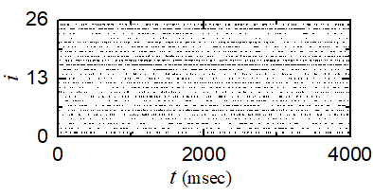


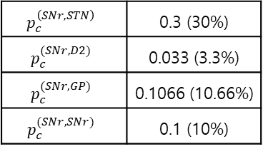
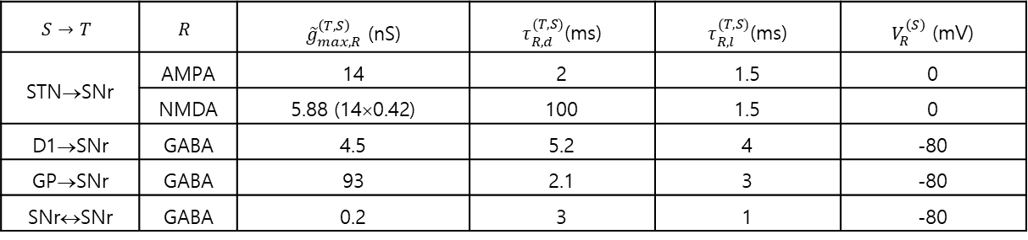
In-Vivo Firing Activities of the SNr Cells
• Current Source $I_{i}^{(SNr)}=I_{vivo}^{(SNr)}−I_{syn,i}^{\left(SNr\right)}+I_{back,i}^{(SNr)}$; $I_{vivo}^{(SNr)}=292 pA$ for $f_{vivo}^{(GP)}=25.5 Hz$
• Synaptic Inputs to the SNr Cells and Random Background Input
- Excitatory synaptic inputs from STN
$I_{syn,i}^{\left(SNr,STN\right)}=I_{AMPA,i}^{(SNr,STN)}+B\left(v_{i}^{(SNr)}\right)⋅I_{NMDA,i}^{\left(SNr,STN\right)}$
- Inhibitory synaptic inputs $I_{GABA,i}^{(SNr,D1)}$, $I_{GABA,i}^{(SNr,GP)}$, and recurrent connections in SNr cells $I_{GABA,i}^{(SNr,SNr)}$
- No DA effect on the synaptic currents
- Random background input: $D_{SNr}^{∗}$=927
• In-vivo Firings for $D_{SNr}^{∗}$=927
$〈f_{i}^{\left(SNr\right)}〉=25.5$ Hz
$$N_{SNr}$$ | $$\text{26}$$
$$N_{D1}$$ | 1,325
$$N_{STN}$$ | 14
$$N_{GP}$$ | 46
$$p_{c}^{\left(SNr,STN\right)}$$ | 0.3 (30%)
$$p_{c}^{(SNr,D2)}$$ | 0.033 (3.3%)
$$p_{c}^{(SNr,GP)}$$ | 0.1066 (10.66%)
$$p_{c}^{(SNr,SNr)}$$ | 0.1 (10%)
$$S→T$$ | $$R$$ | ${\tilde{g}}_{max,R}^{\left(T,S\right)}$ (nS) | $τ_{R,d}^{(T,S)}$(ms) | $τ_{R,l}^{(T,S)}$(ms) | $V_{R}^{\left(S\right)}$ (mV)
STN→SNr | AMPA | 14 | 2 | 1.5 | 0
 | NMDA | 5.88 (14×0.42) | 100 | 1.5 | 0
D1→SNr | GABA | 4.5 | 5.2 | 4 | -80
GP→SNr | GABA | 93 | 2.1 | 3 | -80
SNr↔SNr | GABA | 0.2 | 3 | 1 | -80
10

Slide 11
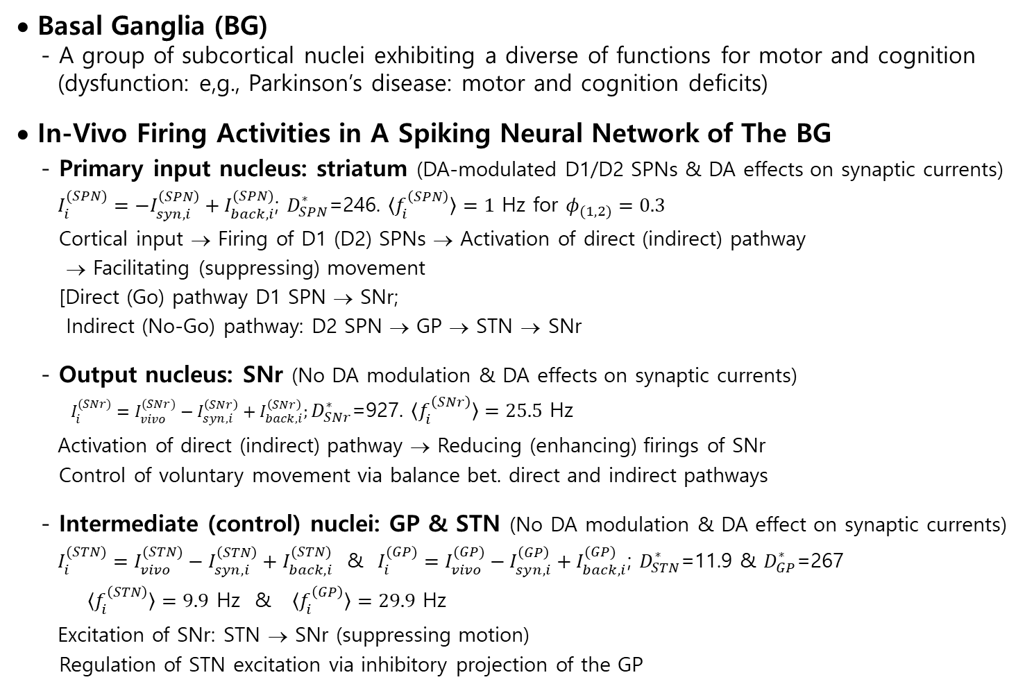
Summary
• Basal Ganglia (BG)
- A group of subcortical nuclei exhibiting a diverse of functions for motor and cognition
(dysfunction: e,g., Parkinson’s disease: motor and cognition deficits)
• In-Vivo Firing Activities in A Spiking Neural Network of The BG
- Primary input nucleus: striatum (DA-modulated D1/D2 SPNs & DA effects on synaptic currents)
$I_{i}^{(SPN)}=−I_{syn,i}^{\left(SPN\right)}+I_{back,i}^{(SPN)}$; $D_{SPN}^{∗}$=246. $〈f_{i}^{\left(SPN\right)}〉=1$ Hz for $φ_{(1,2)}=0.3$
Cortical input → Firing of D1 (D2) SPNs → Activation of direct (indirect) pathway
→ Facilitating (suppressing) movement
[Direct (Go) pathway D1 SPN → SNr;
Indirect (No-Go) pathway: D2 SPN → GP → STN → SNr
- Output nucleus: SNr (No DA modulation & DA effects on synaptic currents)
$I_{i}^{(SNr)}=I_{vivo}^{(SNr)}−I_{syn,i}^{\left(SNr\right)}+I_{back,i}^{\left(SNr\right)};D_{SNr}^{∗}\text{=927}$. $〈f_{i}^{\left(SNr\right)}〉=25.5$ Hz
Activation of direct (indirect) pathway → Reducing (enhancing) firings of SNr
Control of voluntary movement via balance bet. direct and indirect pathways
- Intermediate (control) nuclei: GP & STN (No DA modulation & DA effect on synaptic currents)
$I_{i}^{(STN)}=I_{vivo}^{(STN)}−I_{syn,i}^{\left(STN\right)}+I_{back,i}^{(STN)}$ & $I_{i}^{(GP)}=I_{vivo}^{(GP)}−I_{syn,i}^{\left(GP\right)}+I_{back,i}^{(GP)}$; $D_{STN}^{∗}$=11.9 & $D_{GP}^{∗}$=267
$〈f_{i}^{\left(STN\right)}〉=9.9$ Hz & $〈f_{i}^{\left(GP\right)}〉=29.9$ Hz
Excitation of SNr: STN → SNr (suppressing motion)
Regulation of STN excitation via inhibitory projection of the GP
11

