Slide 1
Dynamical Origin for The Winner-Take-All Competition and Emergence of Sparsely Synchronized Rhythms
in The Hippocampal Dentate Gyrus
S.-Y. Kim and W. Lim
Institute for Computational Neuroscience
Daegu National University of Education
• Hippocampus
- Consisting of the dentate gyrus (DG) and the areas CA3 and CA1
- Play a key role in memory formation, storage, and retrieval
• Pattern Separation
- Pattern Separation: Transforming input patterns into sparser and orthogonalized patterns
- DG: Pre-processor for the CA3: Granule cells (GCs) in the DG performs pattern separation,
facilitating pattern storage and retrieval in the CA3
- Sparsity → Enhancing the pattern separation
• Purpose of Our Study
Investigation of Dynamical Origin of Winner-Take-All (WTA) Competition, Leading
to Sparse Activity of the GCs and Emergence of Sparsely Synchronized Rhythms
in The Hippocampal Dentate Gyrus
1

Slide 2
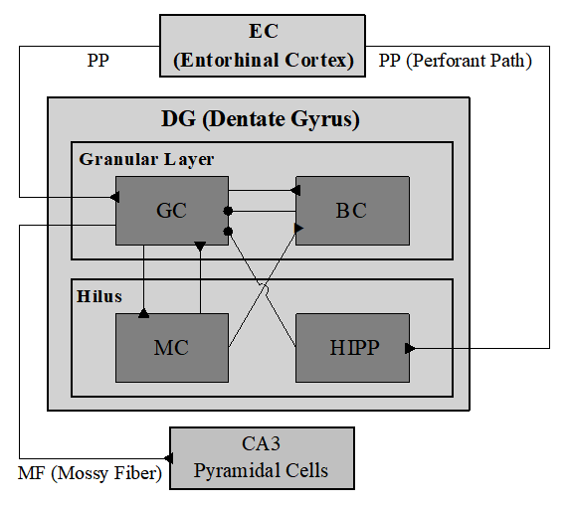
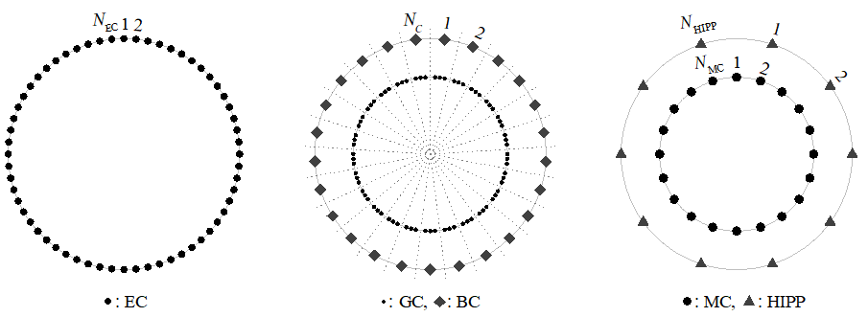
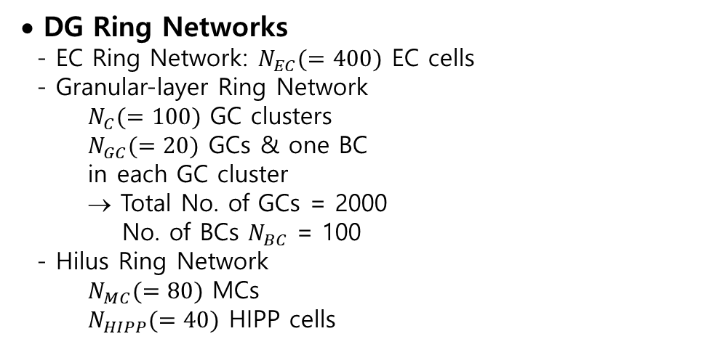
Hippocampal DG Network
• DG Network
- DG receives inputs from the entorhinal cortex (EC)
via the perforant paths (PPs)
- Granular Layer:
Excitatory granule cells (GCs): providing the
output to the CA3 via the mossy fibers (MFs)
Inhibitory basket cells (BCs)
- Hilus:
Excitatory mossy cells (MCs)
Inhibitory hilar perforant path-associated (HIPP)
cells
• DG Ring Networks
- EC Ring Network: $N_{EC}(=400)$ EC cells
- Granular-layer Ring Network
$N_{C}(=100)$ GC clusters
$N_{GC}(=20)$ GCs & one BC
in each GC cluster
→ Total No. of GCs = 2000
No. of BCs $N_{BC}$ = 100
- Hilus Ring Network
$N_{MC}(=80)$ MCs
$N_{HIPP}(=40)$ HIPP cells
2

Slide 3
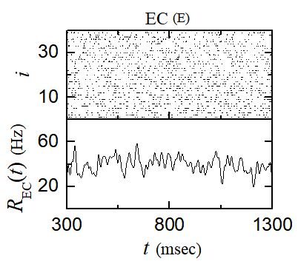
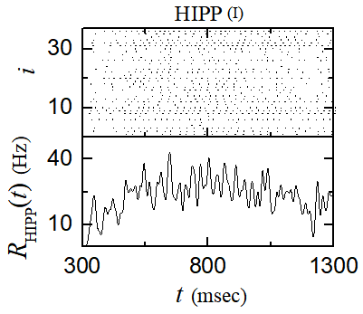
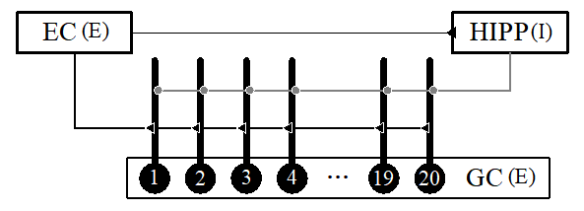
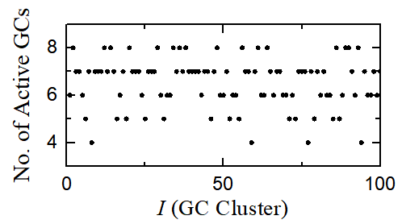
Firing Activity of GCs in The Presence of Only Inputs from EC
• External Inputs from EC
- Direct Excitatory EC Inputs via PP
Input density = 10 %
40 active EC cells
& Remaining ones: silent
Active EC: Poisson spike with 40 Hz
- Indirect Disynaptic Inhibitory EC
Input Mediated by HIPP Cells
Quasi-regular firing activity with diverse MFRs
→ No appearance of synchronized stripes → Desynchronized population behavior
• Firing Activity of GCs in The Presence of Only External Direct Excitatory &
Indirect Disynaptic Inhibitory Inputs from The EC (without MCs and BC)
Firing activity of GCs:
No. of active GCs = 652 → Activation degree of GCs =32.6%
3

Slide 4
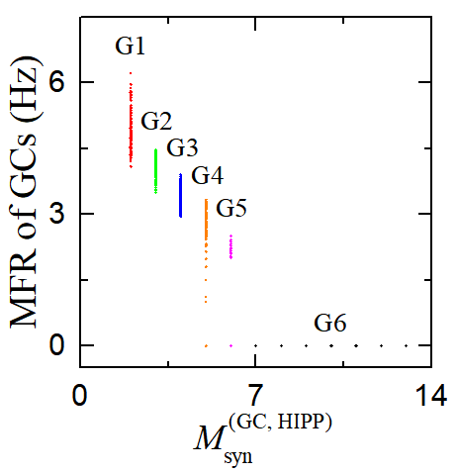
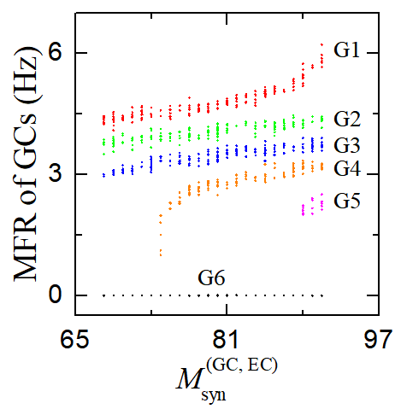
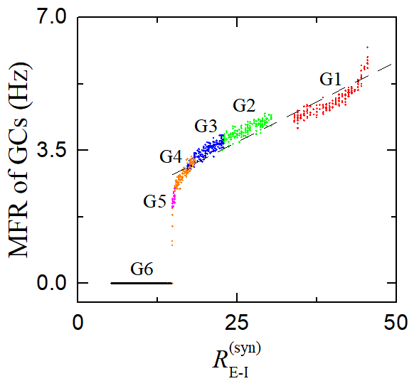

Firing Activity of GCs via Competition between
The Numbers of Pre-synaptic EC and HIPP cells
• Mean Firing Rate (MFR) of GCs vs. No. of Pre-synaptic HIPP & EC Cells
- Firing activity of GCs: Determined via
competition between the direct
excitatory EC input and the indirect
disynaptic inhibitory EC input mediated
by the HIPP Cells
- Depending on $M_{syn}^{(GC,HIPP)}$ (No. of the
inhibitory synapses from the HIPP cells
to the GCs), the whole GCs → 6 groups
• Ratio of No. of Pre-synaptic EC Cells to HIPP Cells
- $R_{E−I}^{(syn)}$: the ratio of No. of excitatory pre-synaptic EC cells $M_{syn}^{(GC,EC)}$
to No. of inhibitory pre-synaptic HIPP cells $M_{syn}^{(GC,HIPP)}$
→ Representing the competition between the external
excitatory (E) input from the EC cells and the
inhibitory (I) input from the HIPP cells
- Threshold for $R_{E−I}^{(syn)}$ = 14.8
→ For $R_{E−I}^{(syn)}$ > 14.8, active; for $R_{E−I}^{(syn)}$ < 14.8, silent
4

Slide 5
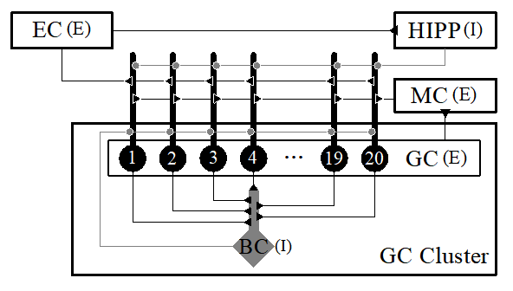
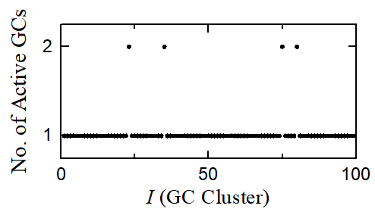
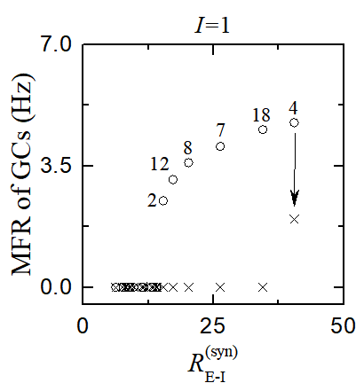
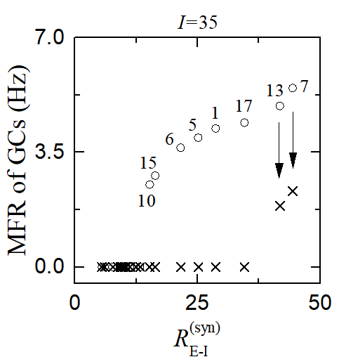
Winner-Take-All Competition in The Whole DG Network
• WTA Competition
- Occurrence of WTA competition through interaction of firing activity of the GCs with the
feedback inhibition of the BC.
- No. of active GCs = 104 → Activation degree of GCs =5.2 % (Sparse activation)
• k =1 WTA • k =2 WTA
- 96 GC clusters - 4 GC clusters
Only one (k =1) k = 2 winners
winner
5

Slide 6
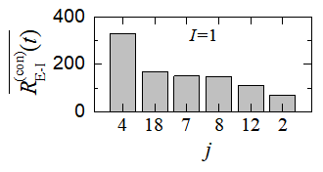
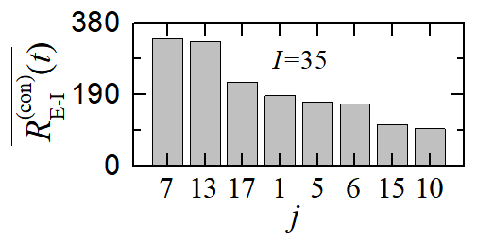
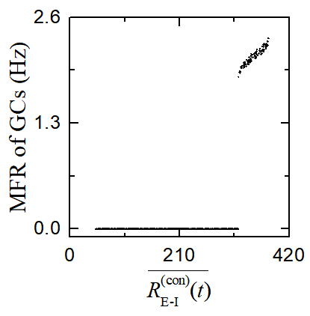
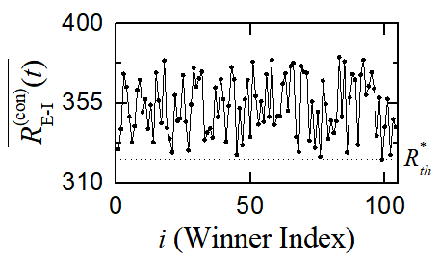

Dynamical Origin of WTA Competition
• Competition between External Excitatory and Inhibitory Inputs into GCs
- Ratio of the external E to I conductance
$R_{E−I}^{\left(con\right)}\left(t\right)=\frac{g_{E}^{\left(I,j\right)}\left(t\right)}{g_{I}^{\left(I,j\right)}\left(t\right)}=\frac{g_{EC}^{\left(I,j\right)}\left(t\right)+g_{MC}^{\left(I,j\right)}\left(t\right)}{g_{HIPP}^{\left(I,j\right)}\left(t\right)}$
- Time-averaged ratio of the external E to I conductance
$\overline{R_{E−I}^{\left(con\right)}(t)}$: Denote the ratio of the external E to I synaptic
inputs in the whole network
- $\overline{R_{E−I}^{\left(con\right)}(t)}>R_{th}^{∗}$→ Winner
• Determination of Winner GCs
- Threshold $R_{th}^{∗}≃323$
$\overline{R_{E−I}^{\left(con\right)}(t)}>R_{th}^{∗}$ → Winner
- Threshold $W_{th}\%$ for winner:
$W_{th}\%=\frac{R_{E−I,max}^{\left(con\right)}−R_{E−I,min}^{\left(con\right)}}{R_{E−I,max}^{\left(con\right)}}×100$
$W_{th}\%=15.1 \%$
6

Slide 7
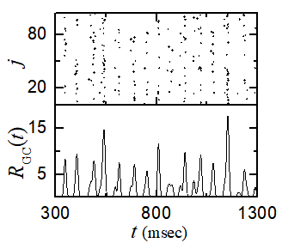
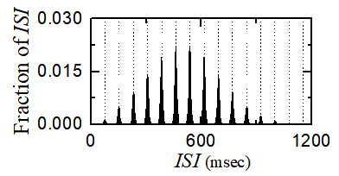
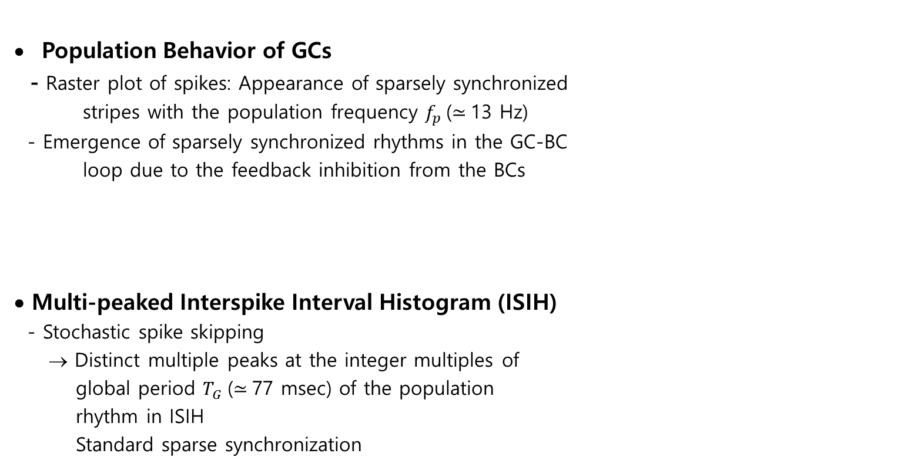
Sparsely Synchronized Rhythm of GCs
Population Behavior of GCs
- Raster plot of spikes: Appearance of sparsely synchronized
stripes with the population frequency $f_{p}$($≃$13 Hz)
- Emergence of sparsely synchronized rhythms in the GC-BC
loop due to the feedback inhibition from the BCs
• Multi-peaked Interspike Interval Histogram (ISIH)
- Stochastic spike skipping
→ Distinct multiple peaks at the integer multiples of
global period $T_{G}$($≃$77 msec) of the population
rhythm in ISIH
Standard sparse synchronization
7

Slide 8
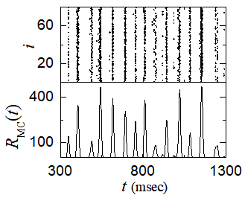
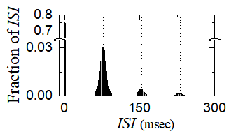
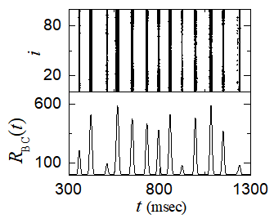
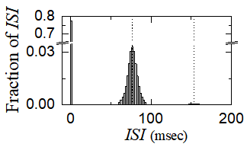
Sparsely Synchronized Rhythm of MCs and BCs
• Sparsely Synchronized Rhythm of MCs
- Emergence of sparsely-synchronized rhythm in MCs
via interaction in the GC-MC loop
- ISIH: Unlike the case of GCs, dominant intrastripe
“bursting" peak and the interstripe multi-peaks
in contrast to the standard sparse synchronization
of GCs with only the interstripe multi-peaks
• Sparsely Synchronized Rhythm of BCs
- Emergence of sparsely-synchronized rhythm in BCs
via interaction in the GC-BC loop
- ISIH: Similar with the case of MCs, dominant intrastripe
“bursting" peak and the interstripe multi-peaks
8

Slide 9
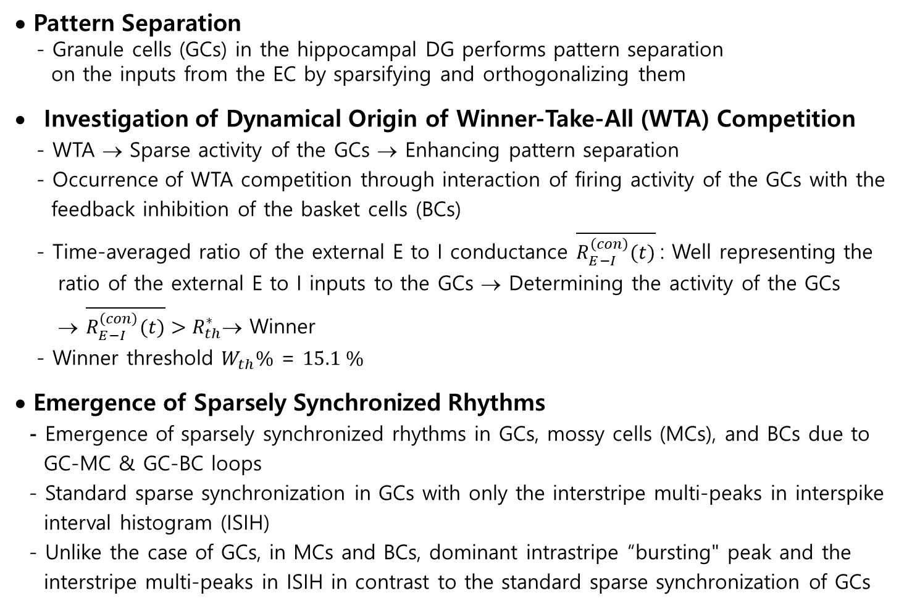
Summary
• Pattern Separation
- Granule cells (GCs) in the hippocampal DG performs pattern separation
on the inputs from the EC by sparsifying and orthogonalizing them
Investigation of Dynamical Origin of Winner-Take-All (WTA) Competition
- WTA → Sparse activity of the GCs → Enhancing pattern separation
- Occurrence of WTA competition through interaction of firing activity of the GCs with the
feedback inhibition of the basket cells (BCs)
- Time-averaged ratio of the external E to I conductance $\overline{R_{E−I}^{\left(con\right)}(t)}$: Well representing the
ratio of the external E to I inputs to the GCs → Determining the activity of the GCs
→ $\overline{R_{E−I}^{\left(con\right)}(t)}>R_{th}^{∗}$→ Winner
- Winner threshold $W_{th}\%$ = $15.1 \%$
• Emergence of Sparsely Synchronized Rhythms
- Emergence of sparsely synchronized rhythms in GCs, mossy cells (MCs), and BCs due to
GC-MC & GC-BC loops
- Standard sparse synchronization in GCs with only the interstripe multi-peaks in interspike
interval histogram (ISIH)
- Unlike the case of GCs, in MCs and BCs, dominant intrastripe “bursting" peak and the
interstripe multi-peaks in ISIH in contrast to the standard sparse synchronization of GCs
9

