Slide 1
Firing Activities of The Single Cells in The Basal Ganglia Controlling Motor Movement
S.-Y. Kim and W. Lim
Institute for Computational Neuroscience
Daegu National University of Education
• Basal Ganglia (BG)
BG: A group of subcortical deep-lying nuclei (“dark basement” of the brain)
- A variety of functions for motor and cognition
- Control of voluntary movement
- Important roles in cognitive processes (e.g., action selection, motor planning)
- Dysfunction:
e.g., Parkinson’s disease (PD) (neurodegenerative disease):
Motor deficits such as slowed movement (bradykinesia), rigidity, and tremor
Cognitive deficit: dementia
• Purpose of Our Study
Studying individual firing activities of the BG cells such as the striatal cells
and the STNs (input nuclei), the SNr (output nucleus), and the GP (intermediate
control nucleus)
1

Slide 2
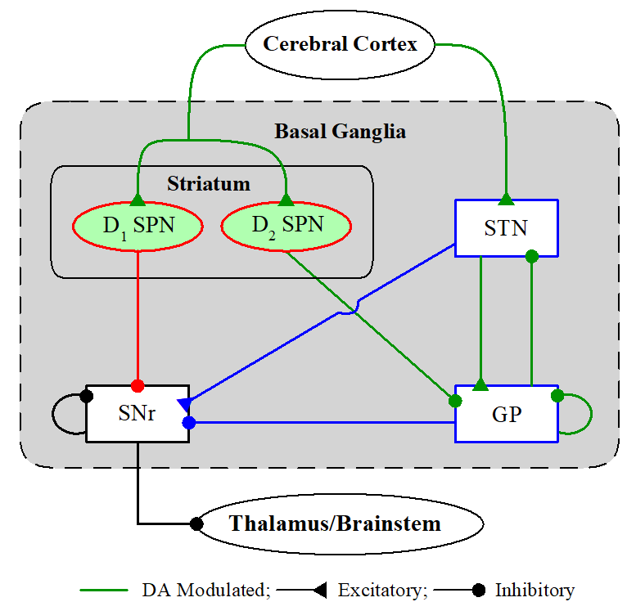
Spiking BG Network
BG: a collection of subcortical nuclei
[DA (dopamine) modulated: green color]
• Input Nuclei
- Striatum (principal input to the BG)
spiny projection neurons (SPNs)
with D1/D2 receptors for the DA
- STN (subthalamic nucleus)
only excitatory nucleus in the BG
• Output Nuclei
- SNr (substantia nigra pars reticulate)
• Intermediate Control Nucleus
- GP (globus pallidus external segment)
D1 SPNs project inhibition directly to the output nuclei SNr/GPi via the direct (“GO”) pathway. On the other hand, D2 SPNs are connected to the SNr/GPi via the indirect (“No-GO”) pathway crossing the GP and the STN.
BG: modulating and gating action selection via balance between the Go and No-Go
pathways → action selection device (gearbox in an auto)
2

Slide 3
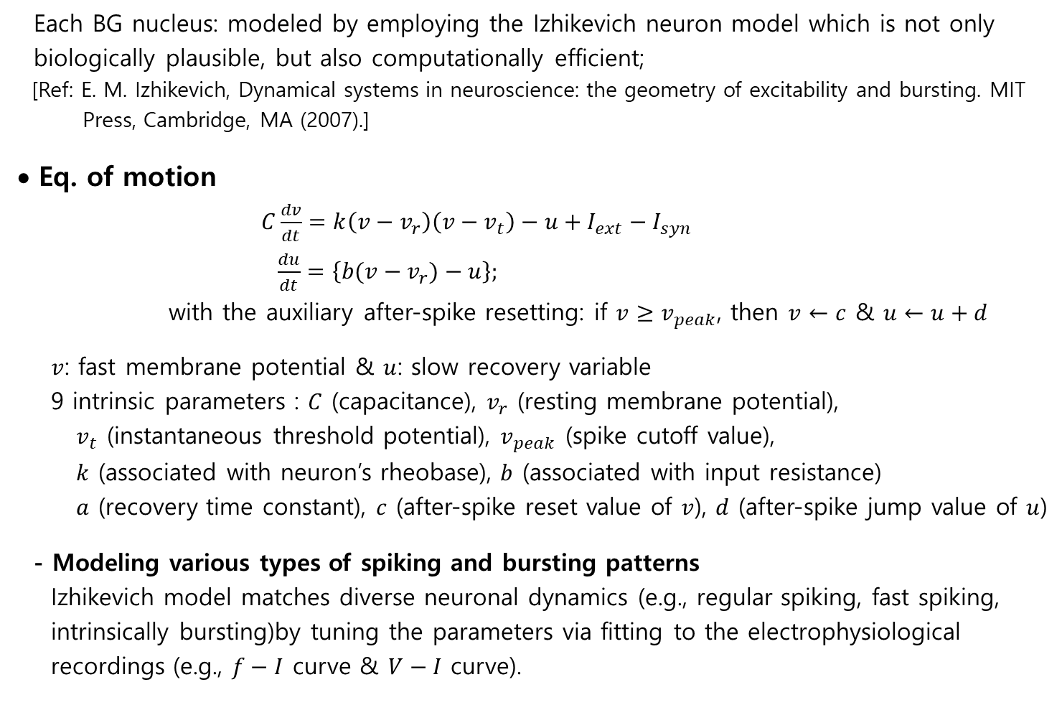
Izhikevich Neuron Model
Each BG nucleus: modeled by employing the Izhikevich neuron model which is not only
biologically plausible, but also computationally efficient;
[Ref: E. M. Izhikevich, Dynamical systems in neuroscience: the geometry of excitability and bursting. MIT
Press, Cambridge, MA (2007).]
• Eq. of motion
$C\frac{dv}{dt}=k\left(v−v_{r}\right)\left(v−v_{t}\right)−u+I_{ext}−I_{syn}$
$\frac{du}{dt}=\left\{b(v−v_{r})−u\right\};$
with the auxiliary after-spike resetting: if $v≥v_{peak}$, then $v←c$ & $u←u+d$
$v$: fast membrane potential & $u$: slow recovery variable
9 intrinsic parameters : $C$ (capacitance), $v_{r}$ (resting membrane potential),
$v_{t}$ (instantaneous threshold potential), $v_{peak}$ (spike cutoff value),
$k$ (associated with neuron’s rheobase), $b$ (associated with input resistance)
$a$ (recovery time constant), $c$ (after-spike reset value of $v$), $d$ (after-spike jump value of $u$)
- Modeling various types of spiking and bursting patterns
Izhikevich model matches diverse neuronal dynamics (e.g., regular spiking, fast spiking,
intrinsically bursting)by tuning the parameters via fitting to the electrophysiological
recordings (e.g., $f−I$ curve & $V−I$ curve).
3

Slide 4
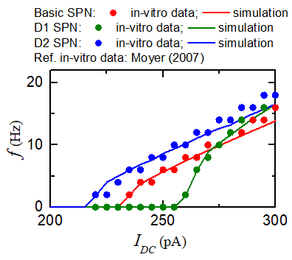
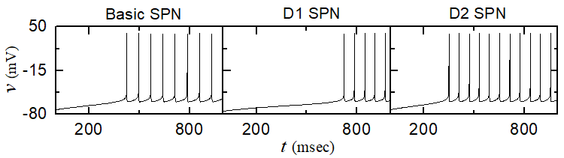
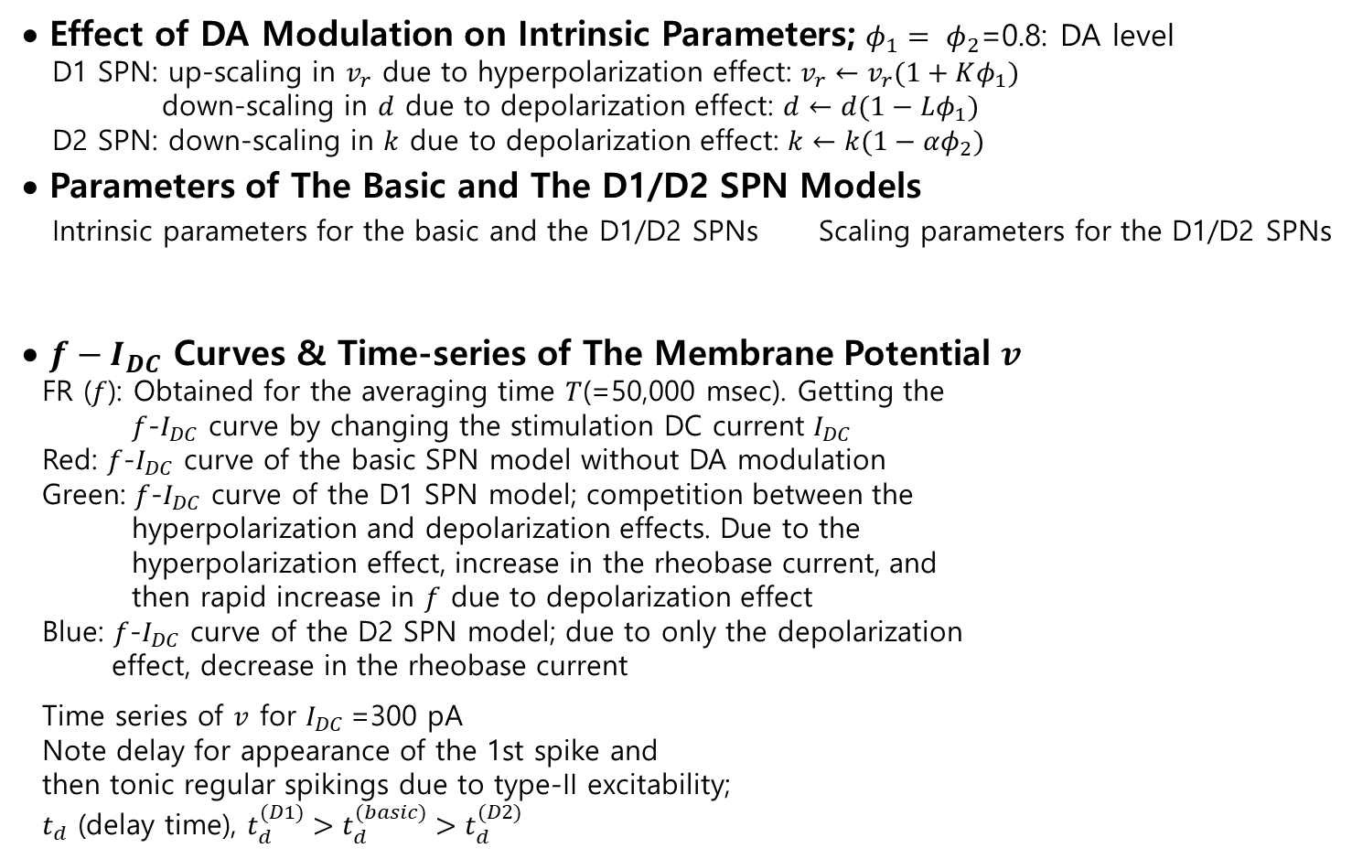


Firing Activities of the Input-nucleus D1/D2 SPNs
• Effect of DA Modulation on Intrinsic Parameters; $φ_{1}= φ_{2}$=0.8: DA level
D1 SPN: up-scaling in $v_{r}$ due to hyperpolarization effect: $v_{r}←v_{r}(1+Kφ_{1})$
down-scaling in $d$ due to depolarization effect: $d←d(1−Lφ_{1})$
D2 SPN: down-scaling in $k$ due to depolarization effect: $k←k(1−αφ_{2})$
• Parameters of The Basic and The D1/D2 SPN Models
Intrinsic parameters for the basic and the D1/D2 SPNs Scaling parameters for the D1/D2 SPNs
• $f−I_{DC}$ Curves & Time-series of The Membrane Potential $v$
FR ($f$): Obtained for the averaging time $T$(=50,000 msec). Getting the
$f$-$I_{DC}$ curve by changing the stimulation DC current $I_{DC}$
Red: $f$-$I_{DC}$ curve of the basic SPN model without DA modulation
Green: $f$-$I_{DC}$ curve of the D1 SPN model; competition between the
hyperpolarization and depolarization effects. Due to the
hyperpolarization effect, increase in the rheobase current, and
then rapid increase in $f$ due to depolarization effect
Blue: $f$-$I_{DC}$ curve of the D2 SPN model; due to only the depolarization
effect, decrease in the rheobase current
Time series of $v$ for $I_{DC}$=300 pA
Note delay for appearance of the 1st spike and
then tonic regular spikings due to type-II excitability;
$t_{d}$ (delay time), $t_{d}^{(D1)}>t_{d}^{(basic)}>t_{d}^{(D2)}$
$$C$$ | $$v_{r}$$ | $$v_{t}$$ | $$k$$ | $$a$$ | $$b$$ | $$c$$ | $$d$$ | $$v_{peak}$$
16.1 | -80 | -29.3 | 1 | 0.01 | -20 | -55 | 84.2 | 40
$$K$$ | $$L$$ | $$α$$
0.0296 | 0.3294 | 0.0347
4

Slide 5
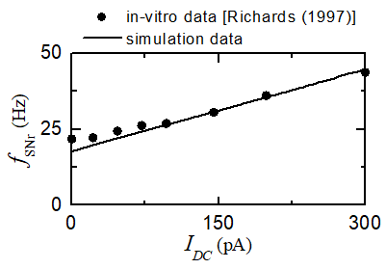
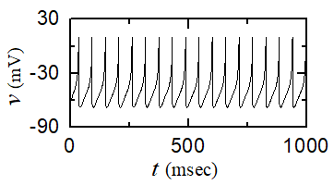
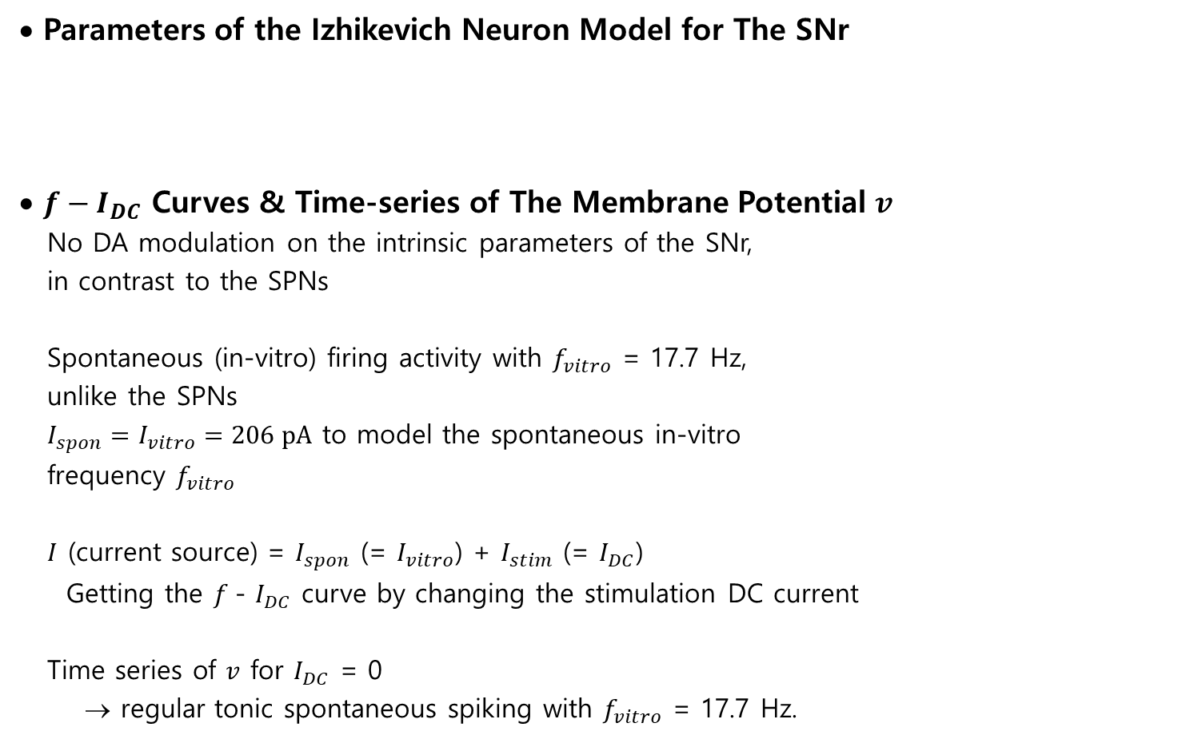

Firing Activities of The Output-nucleus SNr Neurons
• Parameters of the Izhikevich Neuron Model for The SNr
• $f−I_{DC}$ Curves & Time-series of The Membrane Potential $v$
No DA modulation on the intrinsic parameters of the SNr,
in contrast to the SPNs
Spontaneous (in-vitro) firing activity with $f_{vitro}$ = 17.7 Hz,
unlike the SPNs
$I_{spon}=I_{vitro}=206 pA$ to model the spontaneous in-vitro
frequency $f_{vitro}$
$I$ (current source) = $I_{spon}$ (= $I_{vitro}$) + $I_{stim}$ (= $I_{DC}$)
Getting the $f$- $I_{DC}$ curve by changing the stimulation DC current
Time series of $v$ for $I_{DC}$ = 0
→ regular tonic spontaneous spiking with $f_{vitro}$ = 17.7 Hz.
$$C$$ | $$v_{r}$$ | $$v_{t}$$ | $$k$$ | $$a$$ | $$b$$ | $$c$$ | $$d$$ | $$v_{peak}$$ | $$I_{spon}$$
172.1 | -64.58 | -51.8 | 0.7836 | 0.113 | 11.057 | -62.7 | 138.4 | 9.8 | 206
$$I_{DC}=0,I_{spon}=206$$
5

Slide 6
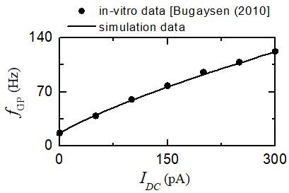
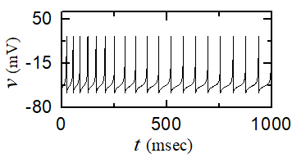

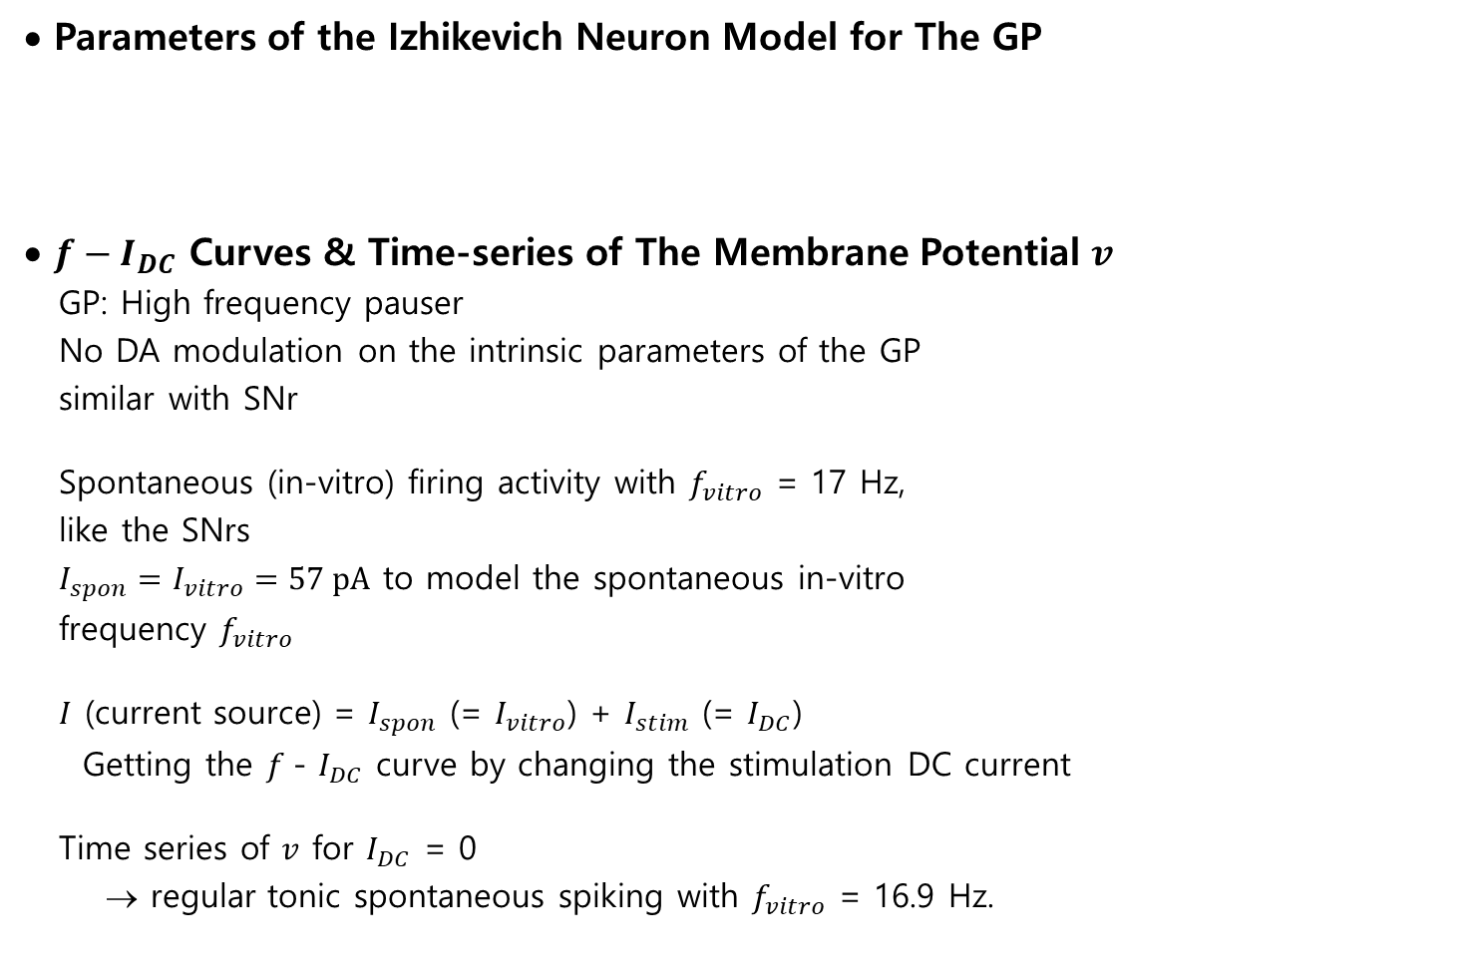
Firing Activities of The GP Neurons
• Parameters of the Izhikevich Neuron Model for The GP
• $f−I_{DC}$ Curves & Time-series of The Membrane Potential $v$
GP: High frequency pauser
No DA modulation on the intrinsic parameters of the GP
similar with SNr
Spontaneous (in-vitro) firing activity with $f_{vitro}$ = 17 Hz,
like the SNrs
$I_{spon}=I_{vitro}=57 pA$ to model the spontaneous in-vitro
frequency $f_{vitro}$
$I$ (current source) = $I_{spon}$ (= $I_{vitro}$) + $I_{stim}$ (= $I_{DC}$)
Getting the $f$- $I_{DC}$ curve by changing the stimulation DC current
Time series of $v$ for $I_{DC}$ = 0
→ regular tonic spontaneous spiking with $f_{vitro}$ = 16.9 Hz.
$$C$$ | $$v_{r}$$ | $$v_{t}$$ | $$k$$ | $$a$$ | $$b$$ | $$c$$ | $$d$$ | $$v_{peak}$$ | $$I_{spon}$$
68.0 | -53.0 | -44.0 | 0.943 | 0.0045 | 3.895 | -58.36 | 0.353 | 25.0 | 57.0
$$I_{DC}=0,I_{spon}=57$$
6

Slide 7
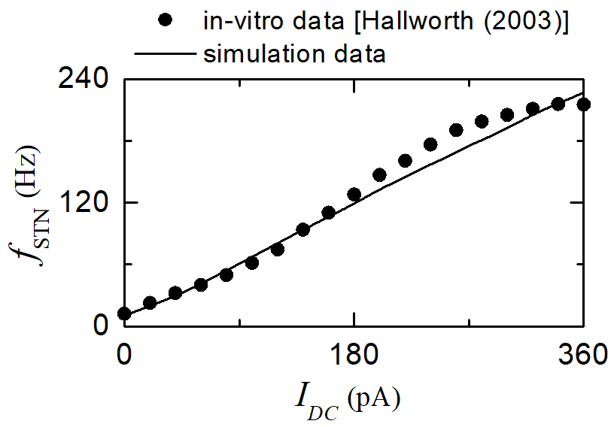
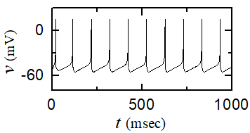
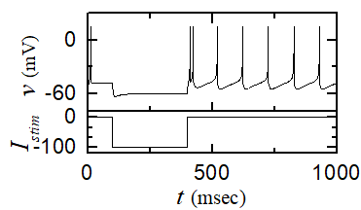

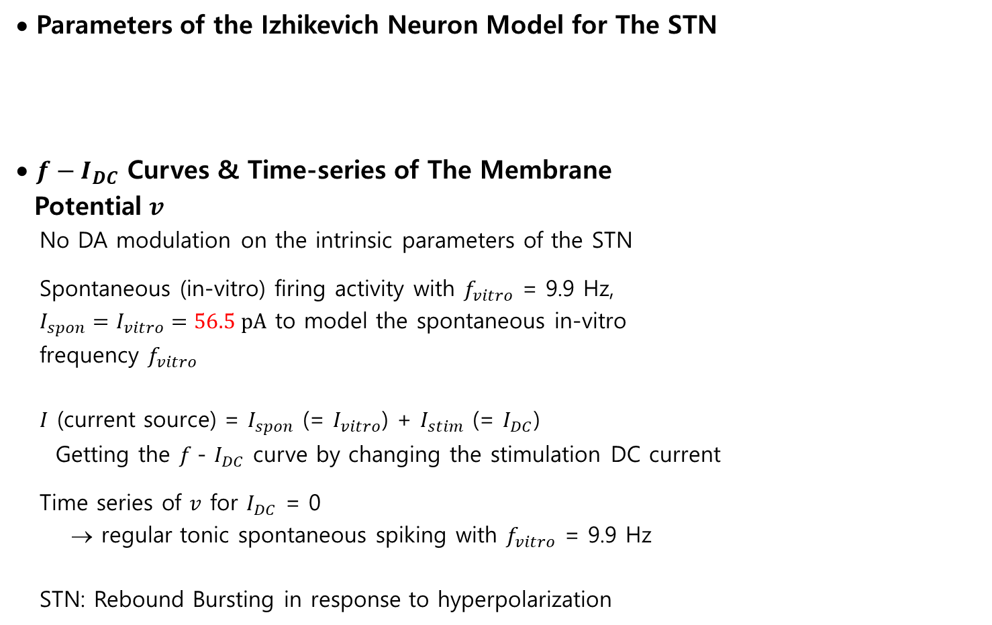
Firing Activities of the STN Neurons
• Parameters of the Izhikevich Neuron Model for The STN
• $f−I_{DC}$ Curves & Time-series of The Membrane
Potential $v$
No DA modulation on the intrinsic parameters of the STN
Spontaneous (in-vitro) firing activity with $f_{vitro}$ = 9.9 Hz,
$I_{spon}=I_{vitro}=56.5 pA$ to model the spontaneous in-vitro
frequency $f_{vitro}$
$I$ (current source) = $I_{spon}$ (= $I_{vitro}$) + $I_{stim}$ (= $I_{DC}$)
Getting the $f$- $I_{DC}$ curve by changing the stimulation DC current
Time series of $v$ for $I_{DC}$ = 0
→ regular tonic spontaneous spiking with $f_{vitro}$ = 9.9 Hz
STN: Rebound Bursting in response to hyperpolarization
$$C$$ | $$v_{r}$$ | $$v_{t}$$ | $$k$$ | $$a$$ | $$b$$ | $$c$$ | $$d$$ | $$v_{peak}$$ | $$I_{spon}$$
23.0 | -56.2 | -41.4 | 0.439 | 0.021 | 4.0 | -47.7 | 17.1 | 15.4 | 56.5
$$I_{DC}=0,I_{spon}=56.5$$
7

Slide 8
Summary
• Basal Ganglia (BG)
- A group of subcortical nuclei exhibiting a diverse of functions for motor and cognition
(dysfunction: e,g., Parkinson’s Disease: motor and cognition deficits)
• Studied Firing Activity of The Izhikevich Neuron Models for The 5 BG Cells:
- Primary input nucleus: striatum (DA-modulated D1/D2 SPNs)
No spontaneous firing activity.
Cortical input → Firing of D1 (D2) SPNs → Activation of direct (indirect) pathway
→ Facilitating (suppressing) movement
[Direct (Go) pathway D1 SPN → SNr;
Indirect (No-Go) pathway: D2 SPN → GPe → STN → SNr]
- Output nucleus: SNr (No DA modulation)
Spontaneous tonic high-frequency firing activity
Activation of direct (indirect) pathway → Reducing (enhancing) firings of SNr
Control of voluntary movement via balance bet Go and No-GO pathways
- Intermediate (control) nuclei: GP & STN (No DA modulation)
Spontaneous firing activities of the GP and the STN
Excitation of SNr: STN → SNr (suppressing motion)
Regulation of STN excitation via inhibitory projection of the GP
8

