Slide 1
Quantitative Analysis of Roles of Direct and Indirect Pathways for Action Selection in The Basal Ganglia
S.-Y. Kim and W. Lim
Institute for Computational Neuroscience
Daegu National University of Education
• Basal Ganglia (BG)
A group of subcortical deep-lying nuclei (“dark basement” of the brain)
- A variety of functions for motor and cognition
Control of voluntary movement and important roles in cognitive processes
(e.g., action selection, motor planning)
• Action Selection
- Laterally interconnected multichannels in BG: Each channel represents an action
- Single channel has direct pathway (DP) resulting in a desired action selection
(“Go” behavior) and indirect pathway (IP) suppressing the desired action selection
(“No-Go” behavior)
- There are two kinds of indirect pathways, intra-channel and inter-channel IPs
• Purpose of Our Study
Quantitative analysis of roles of direct and indirect pathways for action selection
in the spiking neural networks of basal ganglia
1

Slide 2
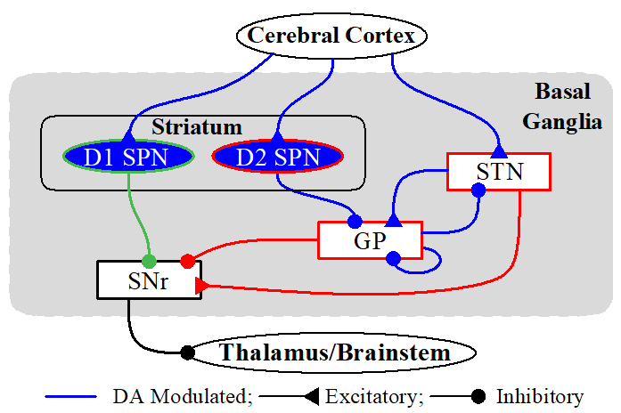
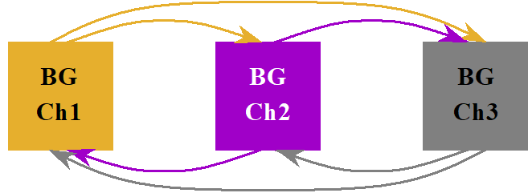
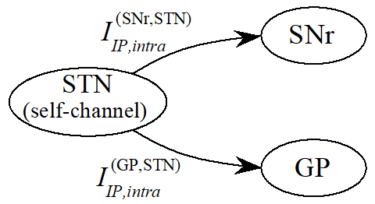
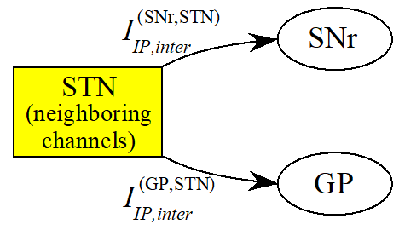
Spiking Neural Networks (SNNs) of The BG
BG: a collection of subcortical nuclei
[DA (dopamine) modulated: green color]
• SNN with A Single Channel
- Input Nuclei: Striatum (principal input to the BG)
spiny projection neurons (SPNs) with D1/D2
receptors for the DA
STN (subthalamic nucleus): only excitatory
nucleus in the BG
- Output Nuclei: SNr (substantia nigra pars reticulate)
- Intermediate Control Nucleus: GP (globus pallidus external segment)
• SNN with 3 Competing Channels:
- Each channel represents an action
- Inter-channel connections are made via widespread
diffusive excitation from the STN in a channel to
the target nuclei, SNr and GP
• Intra-channel Synaptic Connections • Inter-channel Synaptic Connections
- From STN to SNr neurons and GP - From STNs in the two
neighboring in the same self-channel channels to SNr neurons and GP
2

Slide 3
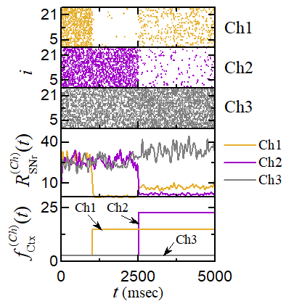
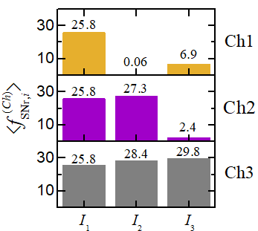
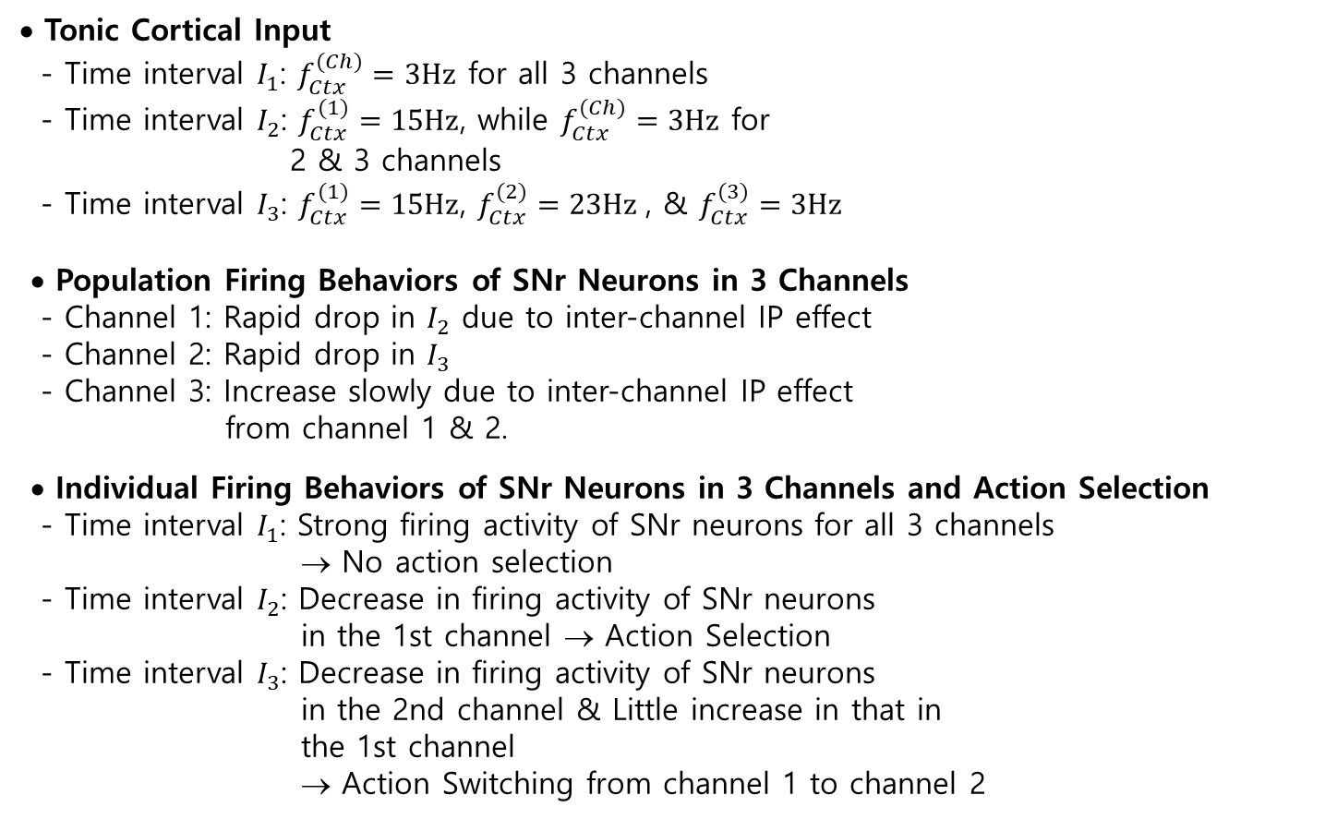
Population and Individual Behaviors of SNr Neurons
• Tonic Cortical Input
- Time interval $I_{1}$: $f_{Ctx}^{(Ch)}=3Hz$ for all 3 channels
- Time interval $I_{2}$: $f_{Ctx}^{(1)}=15Hz$, while $f_{Ctx}^{(Ch)}=3Hz$ for
2 & 3 channels
- Time interval $I_{3}$: $f_{Ctx}^{(1)}=15Hz$, $f_{Ctx}^{(2)}=23Hz$, & $f_{Ctx}^{(3)}=3Hz$
• Population Firing Behaviors of SNr Neurons in 3 Channels
- Channel 1: Rapid drop in $I_{2}$ due to inter-channel IP effect
- Channel 2: Rapid drop in $I_{3}$
- Channel 3: Increase slowly due to inter-channel IP effect
from channel 1 & 2.
• Individual Firing Behaviors of SNr Neurons in 3 Channels and Action Selection
- Time interval $I_{1}$: Strong firing activity of SNr neurons for all 3 channels
→ No action selection
- Time interval $I_{2}$: Decrease in firing activity of SNr neurons
in the 1st channel → Action Selection
- Time interval $I_{3}$: Decrease in firing activity of SNr neurons
in the 2nd channel & Little increase in that in
the 1st channel
→ Action Switching from channel 1 to channel 2
3

Slide 4
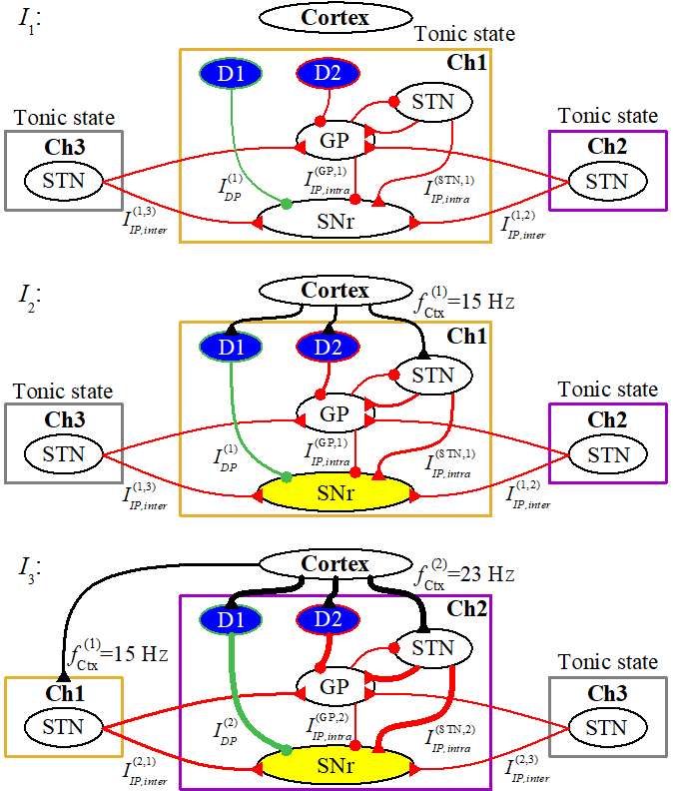
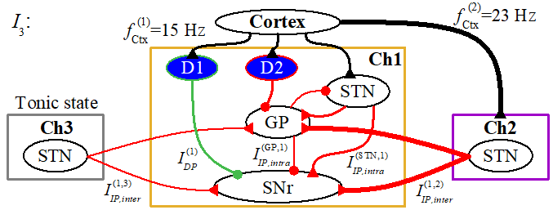
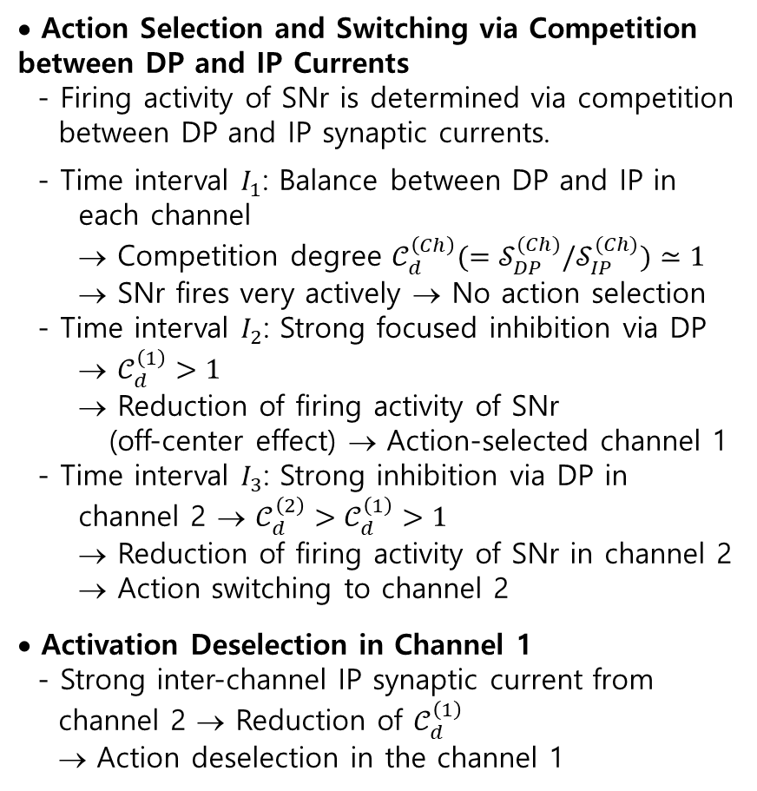
Action Selection and Switching
• Action Selection and Switching via Competition between DP and IP Currents
- Firing activity of SNr is determined via competition
between DP and IP synaptic currents.
- Time interval $I_{1}$: Balance between DP and IP in
each channel
→ Competition degree $𝒞_{d}^{\left(Ch\right)}(=𝒮_{DP}^{(Ch)}/𝒮_{IP}^{(Ch)})≃1$
→ SNr fires very actively → No action selection
- Time interval $I_{2}$: Strong focused inhibition via DP
→ $𝒞_{d}^{\left(1\right)}>1$
→ Reduction of firing activity of SNr
(off-center effect) → Action-selected channel 1
- Time interval $I_{3}$: Strong inhibition via DP in
channel 2 → $𝒞_{d}^{\left(2\right)}>𝒞_{d}^{\left(1\right)}>1$
→ Reduction of firing activity of SNr in channel 2
→ Action switching to channel 2
• Activation Deselection in Channel 1
- Strong inter-channel IP synaptic current from
channel 2 → Reduction of $𝒞_{d}^{\left(1\right)}$
→ Action deselection in the channel 1
4

Slide 5
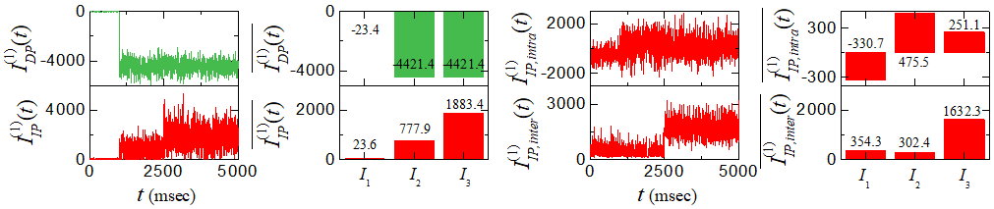
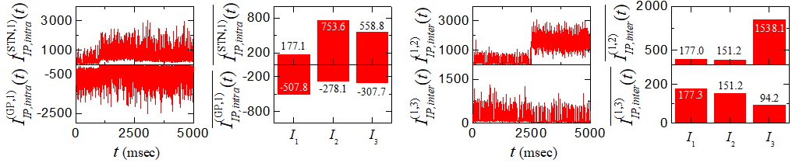
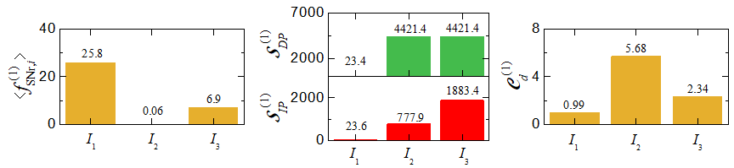

Quantitative Analysis for Action Selection in The Channel 1
• DP Synaptic Currents in The Channel 1
- Inhibitory DP current: Strongly decrease in $I_{2}$& $I_{3}$
due to cortical input $f_{Ctx}^{(1)}=15Hz$
→ Strong focused inhibition to SNr
→ Suppress the firing activity of SNr
• IP Synaptic Currents in The Channel 1
- Excitatory IP current: Increase in $I_{2}$and more increase in $I_{3}$
- Decomposition of IP current into intra-and inter-channel
IP current:
Increase in intra-channel IP current from STN in $I_{2}$& $I_{3}$
Decrease in magnitude of IP current from GP in $I_{2}$& $I_{3}$
→ Increase in intra-channel IP current in $I_{2}$
and little decrease in $I_{3}$
Increase in inter-channel IP current from channel 2 in $I_{3}$
Decrease in inter-channel IP current from channel 3
→ Increase in inter-channel IP current in $I_{3}$
• Strengths of DP & IP Currents and Competition Degree
- $I_{1}$: Balance between DP and IP → $𝒞_{d}^{\left(1\right)}≃1$
- $I_{2}$: $𝒮_{DP}^{(1)}>𝒮_{IP}^{(1)}$ → $𝒞_{d}^{\left(1\right)}=5.68$
- $I_{3}$: Increase in IP
→ Decrease in $𝒞_{d}^{\left(1\right)}=2.34$
5

Slide 6
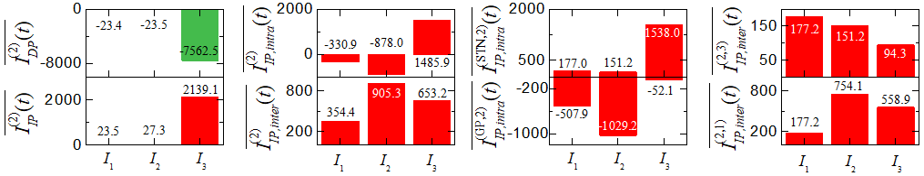
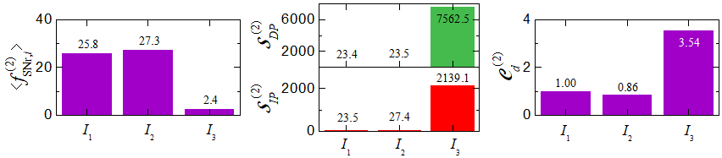
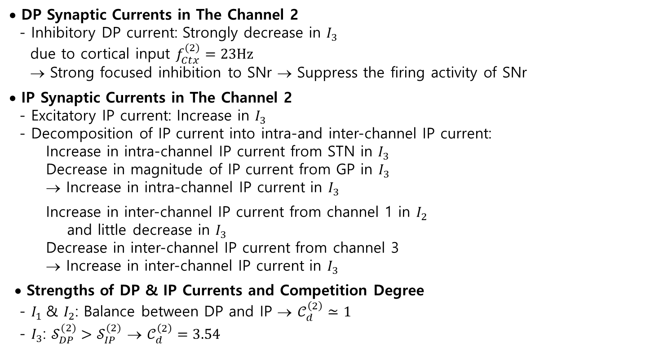
Quantitative Analysis for Action Selection in The Channel 2
• DP Synaptic Currents in The Channel 2
- Inhibitory DP current: Strongly decrease in $I_{3}$
due to cortical input $f_{Ctx}^{(2)}=23Hz$
→ Strong focused inhibition to SNr → Suppress the firing activity of SNr
• IP Synaptic Currents in The Channel 2
- Excitatory IP current: Increase in $I_{3}$
- Decomposition of IP current into intra-and inter-channel IP current:
Increase in intra-channel IP current from STN in $I_{3}$
Decrease in magnitude of IP current from GP in $I_{3}$
→ Increase in intra-channel IP current in $I_{3}$
Increase in inter-channel IP current from channel 1 in $I_{2}$
and little decrease in $I_{3}$
Decrease in inter-channel IP current from channel 3
→ Increase in inter-channel IP current in $I_{3}$
• Strengths of DP & IP Currents and Competition Degree
- $I_{1}$& $I_{2}$: Balance between DP and IP → $𝒞_{d}^{\left(2\right)}≃1$
- $I_{3}$: $𝒮_{DP}^{(2)}>𝒮_{IP}^{(2)}$ → $𝒞_{d}^{\left(2\right)}=3.54$
6

Slide 7
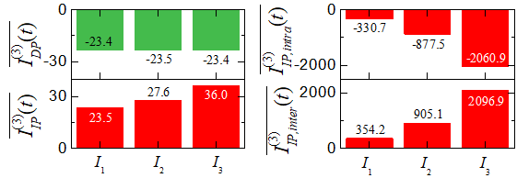
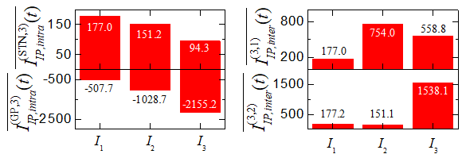
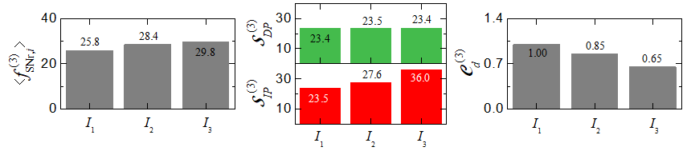
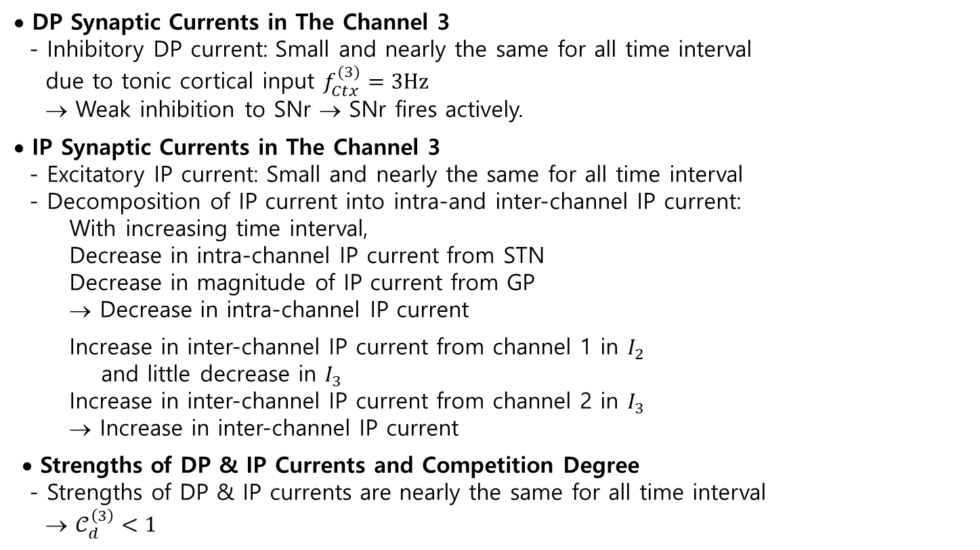
Quantitative Analysis for Action Selection in The Channel 3
• DP Synaptic Currents in The Channel 3
- Inhibitory DP current: Small and nearly the same for all time interval
due to tonic cortical input $f_{Ctx}^{(3)}=3Hz$
→ Weak inhibition to SNr → SNr fires actively.
• IP Synaptic Currents in The Channel 3
- Excitatory IP current: Small and nearly the same for all time interval
- Decomposition of IP current into intra-and inter-channel IP current:
With increasing time interval,
Decrease in intra-channel IP current from STN
Decrease in magnitude of IP current from GP
→ Decrease in intra-channel IP current
Increase in inter-channel IP current from channel 1 in $I_{2}$
and little decrease in $I_{3}$
Increase in inter-channel IP current from channel 2 in $I_{3}$
→ Increase in inter-channel IP current
• Strengths of DP & IP Currents and Competition Degree
- Strengths of DP & IP currents are nearly the same for all time interval
→ $𝒞_{d}^{\left(3\right)}<1$
7

Slide 8
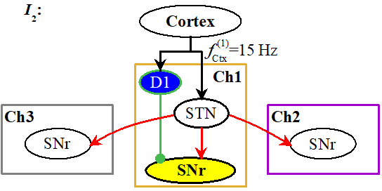
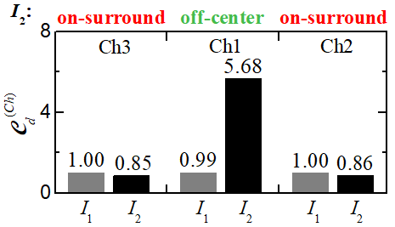
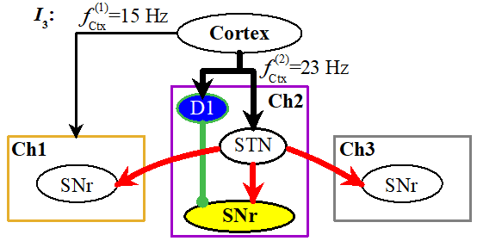
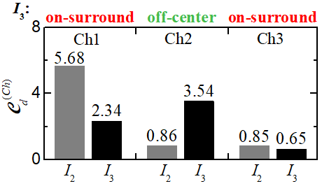
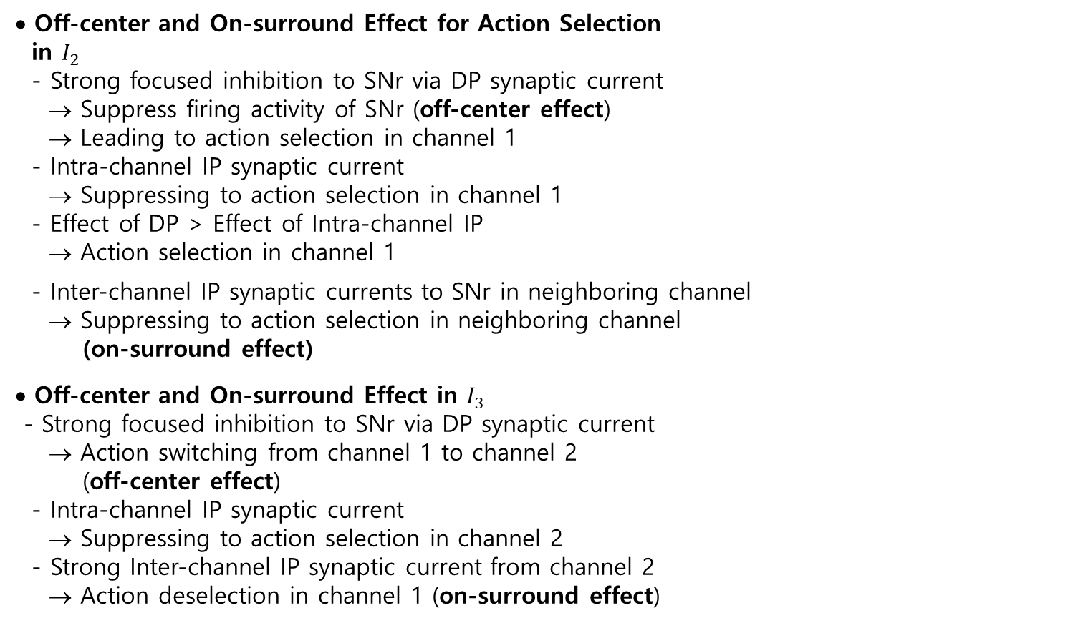
Off-center and On-surround Effect via DP and IP Synaptic Currents
• Off-center and On-surround Effect for Action Selection
in $I_{2}$
- Strong focused inhibition to SNr via DP synaptic current
→ Suppress firing activity of SNr (off-center effect)
→ Leading to action selection in channel 1
- Intra-channel IP synaptic current
→ Suppressing to action selection in channel 1
- Effect of DP > Effect of Intra-channel IP
→ Action selection in channel 1
- Inter-channel IP synaptic currents to SNr in neighboring channel
→ Suppressing to action selection in neighboring channel
(on-surround effect)
• Off-center and On-surround Effect in $I_{3}$
- Strong focused inhibition to SNr via DP synaptic current
→ Action switching from channel 1 to channel 2
(off-center effect)
- Intra-channel IP synaptic current
→ Suppressing to action selection in channel 2
- Strong Inter-channel IP synaptic current from channel 2
→ Action deselection in channel 1 (on-surround effect)
8

Slide 9
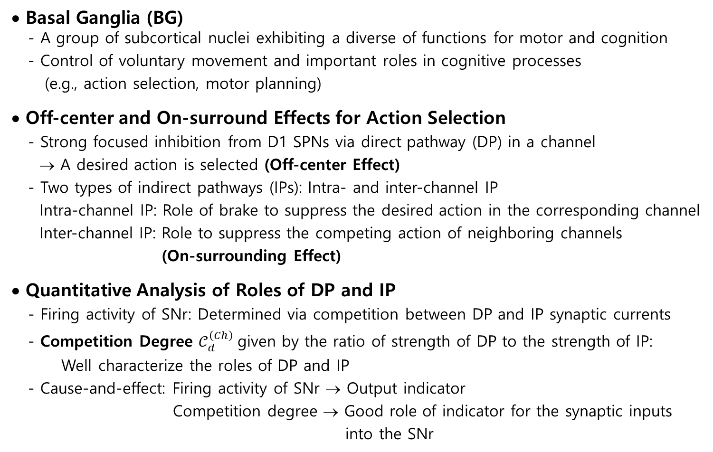
Summary
• Basal Ganglia (BG)
- A group of subcortical nuclei exhibiting a diverse of functions for motor and cognition
- Control of voluntary movement and important roles in cognitive processes
(e.g., action selection, motor planning)
• Off-center and On-surround Effects for Action Selection
- Strong focused inhibition from D1 SPNs via direct pathway (DP) in a channel
→ A desired action is selected (Off-center Effect)
- Two types of indirect pathways (IPs): Intra- and inter-channel IP
Intra-channel IP: Role of brake to suppress the desired action in the corresponding channel
Inter-channel IP: Role to suppress the competing action of neighboring channels
(On-surrounding Effect)
• Quantitative Analysis of Roles of DP and IP
- Firing activity of SNr: Determined via competition between DP and IP synaptic currents
- Competition Degree $𝒞_{d}^{\left(Ch\right)}$given by the ratio of strength of DP to the strength of IP:
Well characterize the roles of DP and IP
- Cause-and-effect: Firing activity of SNr → Output indicator
Competition degree → Good role of indicator for the synaptic inputs
into the SNr
9

